Slide 1
eTRIKS
Informatics Tools Reducing the time from “Bench to Practice”

Slide 2
What is Translational Research (TR)
T0: Preclinical and animal studies ->
  Defining Mechanisms, Targets, Biomarkers and Lead Molecules / Relevant & New Animal Models
T1: Proof of concept – Phase 1 Clinical Trials ->
  New Methods of prognosis (N.B Pre-disease studies needed, using “easily obtained” samples: biofluids – blood, urine), diagnostics, treatment and prevention (linked to prognosis).
T2: Translation to patients – Phase 2-3 Clinical Trials ->
  Controlled Studies leading to effective care
T3: Translation to practice – Phase 4 Clinical trials and clinical outcomes research ->
  Delivery of recommended and timely care to the right patient (Personalised medicine)
T4: Translation to community – Population level outcome research ->
  True benefit to society
Basic Science -> Human Studies
New data -> clinic
Adapted from Blumberg et al, 2012

Slide 3
Translational Research Produces a large Number of diverse Samples
Clinical
  Demographics
  Medications
  Incidence
  Real-time measurements (Telemetry)
  Blood pressure
  Routine blood work
IHC
MRI/X-RAY
Spirometry, eNOSE (Context)
Animal
Cell Culture
Omics
  Microarrays
  Cytokine arrays
  Auto-antibody reactivity
  DNAseq (CNV, indel, SNP -> GWAS)
  RNAseq (
  ChIPseq
  Methylation analysis
  Proteomics
  Lipidomics
  Metabolomics

Slide 4
Samples Collected - Omics
Transcriptomics
Proteomics
Lipidomics
Metabolomics
Epigenomics
GWAS
SNP analysis
Imaging
MRI
Histology
Animal Models
  Microarrays
  Cytokine arrays
  Auto-antibody reactivity
  DNAseq (CNV, indel, SNP -> GWAS)
  RNAseq (
  ChIPseq
  Methylation analysis
  Proteomics
  Lipidomics
  Metabolomics
eQTL

Slide 5
Data Types Produced
  Microarrays
  Cytokine arrays
  Auto-antibody reactivity
  DNAseq (CNV, indel, SNP -> GWAS)
  RNAseq (
  ChIPseq
  Methylation analysis
  Proteomics
  Lipidomics
  Metabolomics

Slide 6
Mutation analysis
Identifying the risks of alterations associated with the diseases
Next generation sequencing
SNIP

Slide 7
Transcriptomics
Understanding the gene signatures of the diseases
RNA Sequencing
Microarrays

Slide 8
Translational Research “Bottlenecks”
Steps
Bottlenecks
T0: Preclinical and animal studies
T1: Proof of concept – Phase 1 Clinical Trials
T2: Translation to patients – Phase 2-3 Clinical Trials
T3: Translation to practice – Phase 4 Clinical trials and clinical outcomes research
T4: Translation to community – Population level outcome research
Incomplete phenotypic understanding of complex diseases, plus lack of integration of complexity factors
Lack of SOPs for sample collection, handling and analysis
Inadequate organisational model (Research organisation “silos”)
Weak PPP activity integration
Continuous interaction and feedback required
Insufficient investigator base
Regulatory burden
Deficiencies in funding
Need for integrated centres
Inefficient academia-industry interactions
Basic Science -> Human Studies
New data -> clinic
Adapted from Blumberg et al, 2012

Slide 9
ΙΤ infrastructure components of TR
eDC, eHR, eCRF system
Robust forms
Biobank / LIMS
Sample Tracking
Data Model
Data Store
Analytical Workflows
Collaboration Platorm

Slide 10
Clinical Data - Individual Input / CRF
Clinicians / Researchers create the project specific CRF fields
(Clinical data ontology)
Provided with an interactive web form
Project Specific Data Model created by eTRIKS
+
Data loaded on Transmart
Data I/O implemented on eTRIKS/Project Server
Data analysed on Transmart

Slide 11
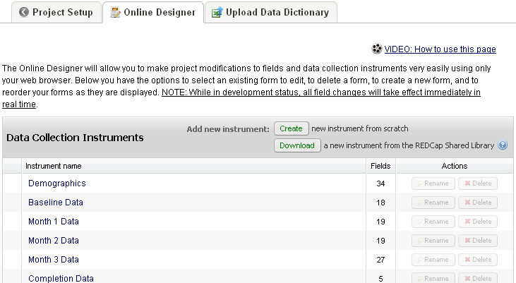
Example eCRF
You develop your data collection instruments (surveys and data entry forms)
in the online designer.

Slide 12
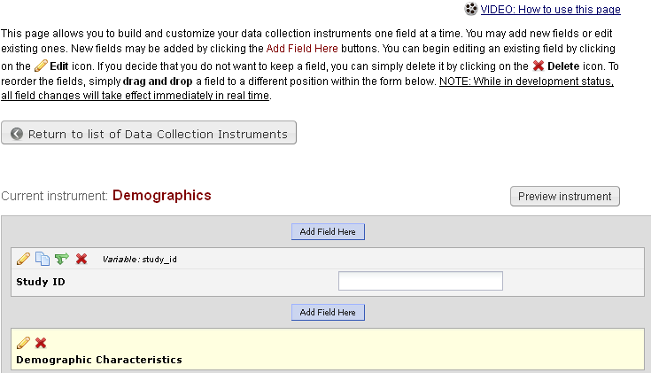
In the online designer window, and other places throughout REDCap,
there are instructions and videos available to help you learn how to use it.
Watch
Read
Learn

Slide 13
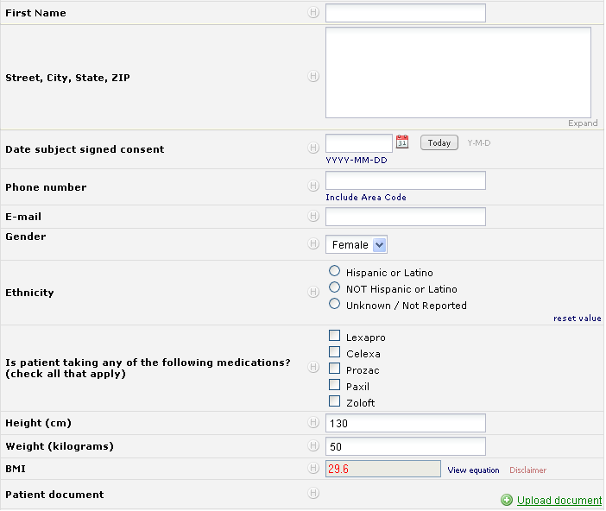
There are many types of fields available.

Slide 14
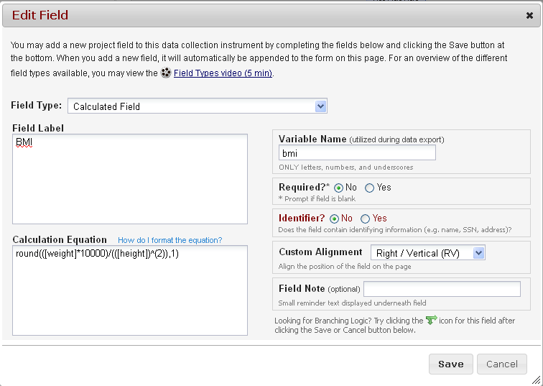
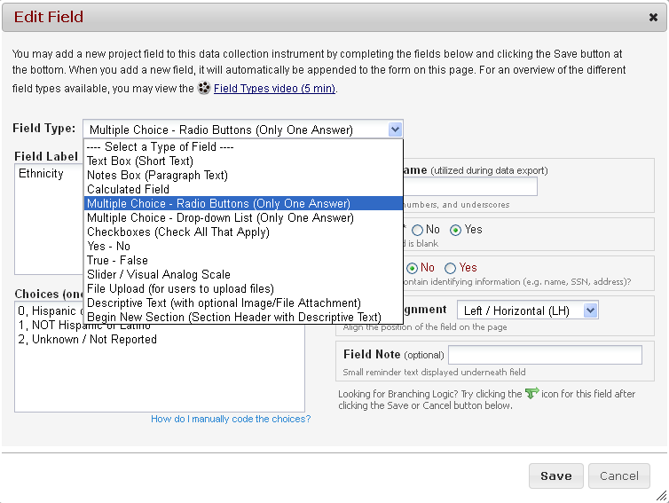
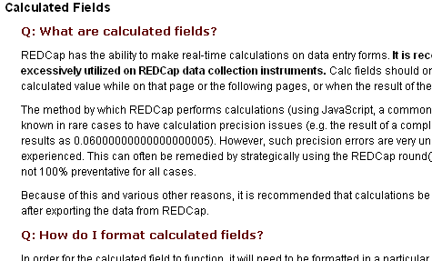
There is help on how to format equations.
When developing your forms, you choose the field type for each field.
You can also create calculated fields.

Slide 15
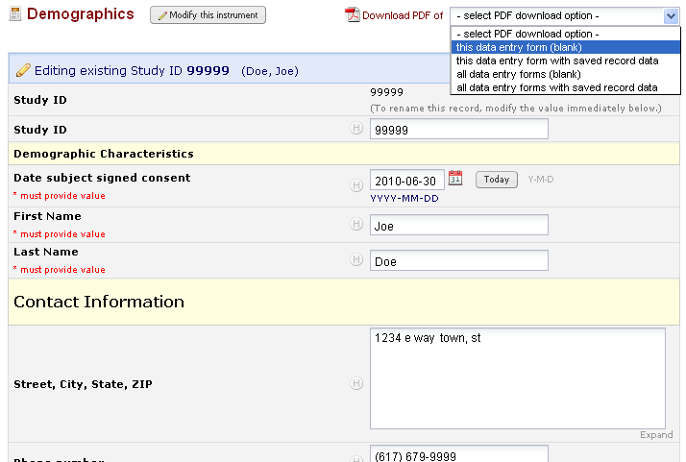
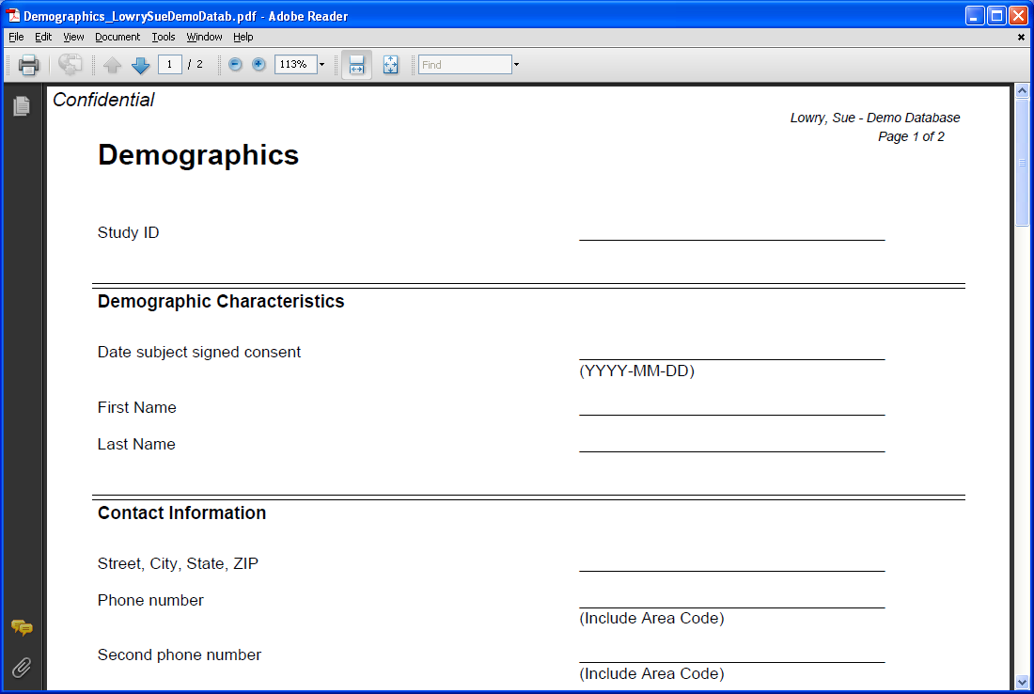
You can create PDFs of any of the data collection instruments – with or without data.

Slide 16
Clinical Data – Output (Analyse & Mass download)
Comparative Statistics
Clustering (Stratification)
Visualisation
STANDARD OUTPUT FORMAT (csv/excel, R, SPSS, SAS, Matlab) -> Downstream Processing
UML -> full annotation

Slide 17
Clinical Data – Issues
Confounders
Variance
QC methods
Data integration
Cross study analysis capabilities (out of scope, but can mention)

Slide 18
ETL -> TM
Transmart ETL and Tree Structure
  Analyse get a report

Slide 19
KM Platform
Hypothesis
Provenance
Reports
Discussions
Workflows

Slide 20
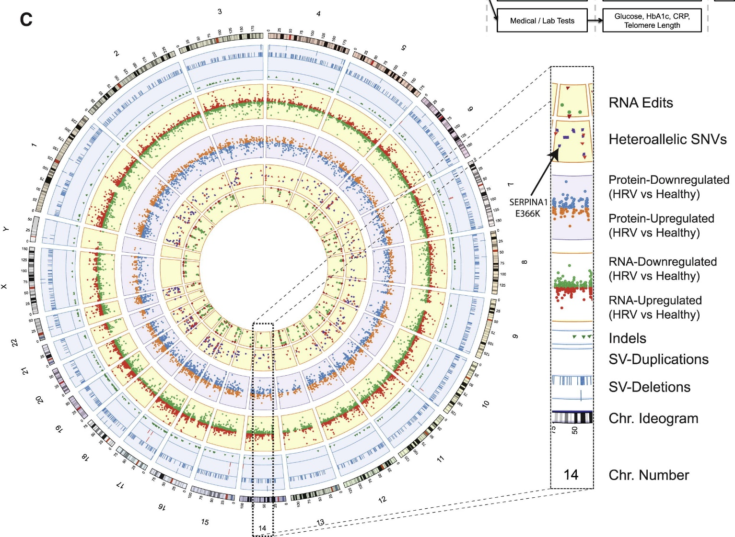
Data intergration and visualisation

Slide 21

Unbiased Biomarkers for the Prediction of Respiratory Disease
Outcomes
Innovative Medicines Initiative
call topic:
Understanding Severe Asthma

Slide 22
Severe asthma
Facts
  Despite all our attempts, the clinical course of severe asthma is far from optimal
  Unfortunately, the development of new drugs for severe asthma has not been successful during the past years
Reasons?
  Severe asthma is not a single disease: individual patients are clinically very different
  There are multiple and co-existent disease mechanisms
  At present the efficacy of new drugs cannot be predicted from preclinical models nor from currently defined patient characteristics

Slide 23
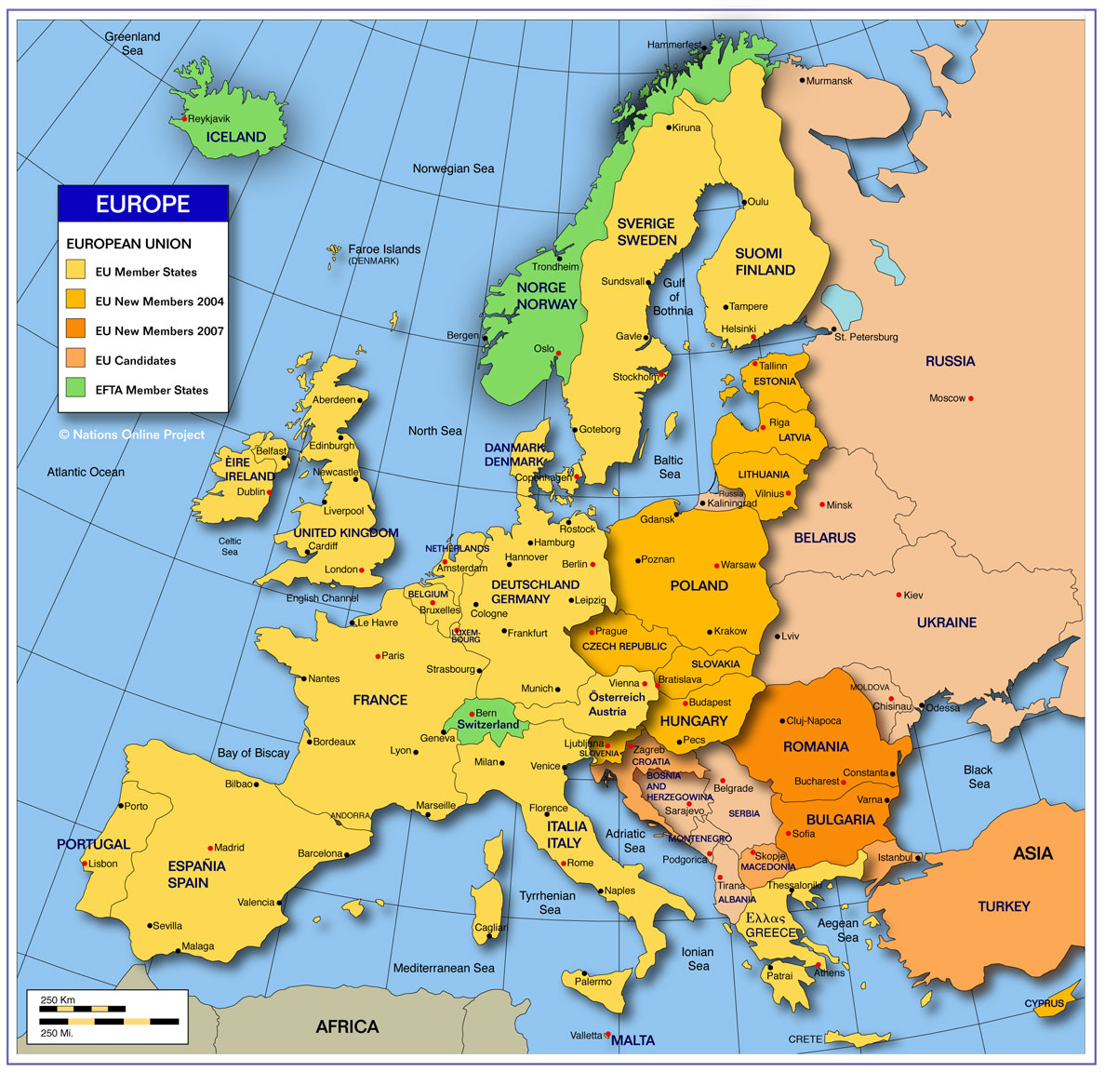
U-BIOPRED - Geography
acad*
pat org*
*
SME*
*
*
*
*
*
*
*
*
*
*
*
*
*
*
*
*
*
*
*
*
*
*
*
*
*
*
*
*
*
*
*

Slide 24
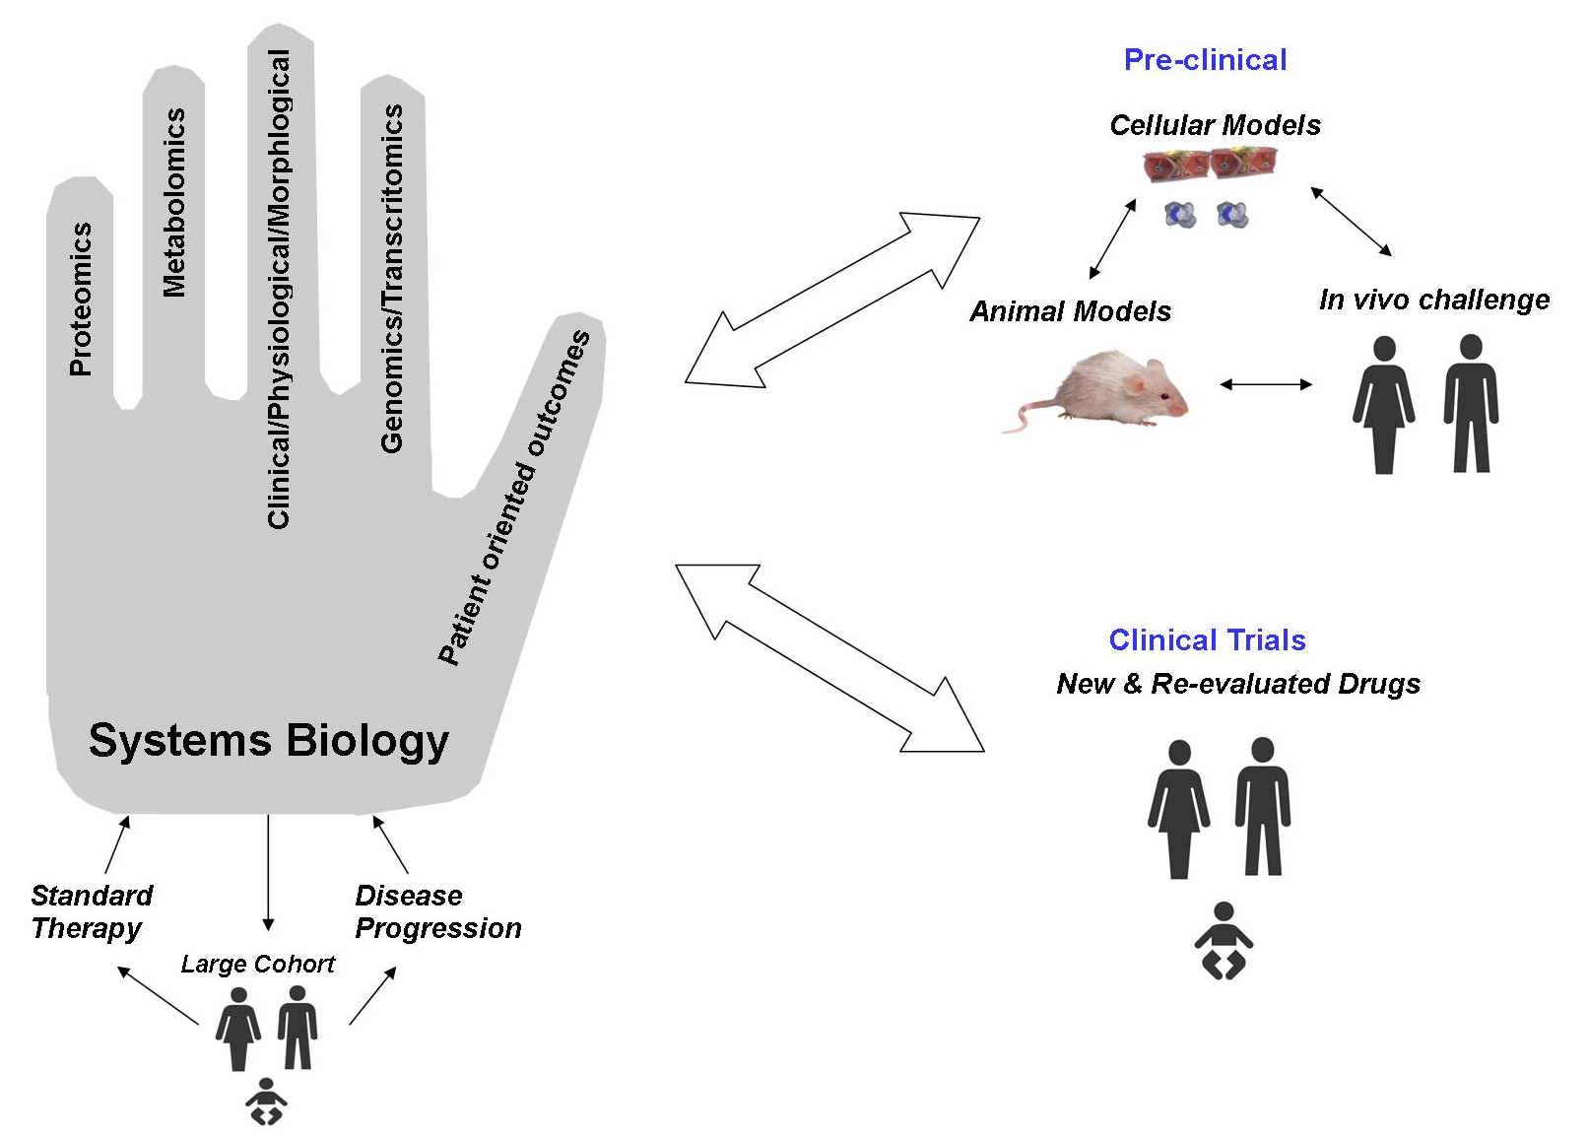
U-BIOPRED Aim: Handprint

Slide 25
TR Study design
Plan & Build Content
Project name
Study name & description
Study Group / Cohort Definition
Screen & Populate Patients
Plan visits
Plan Sampling
Define Datasets produced
Analyse
Form Hypothesis
Define Materials and Methods
Perform Analysis
Evaluate Results
Disseminate
Structure / Re-Structure Data
Annotate / Tag
Store Data and Results
Disseminate
Notes:
This is the first step for any new project.

Slide 26
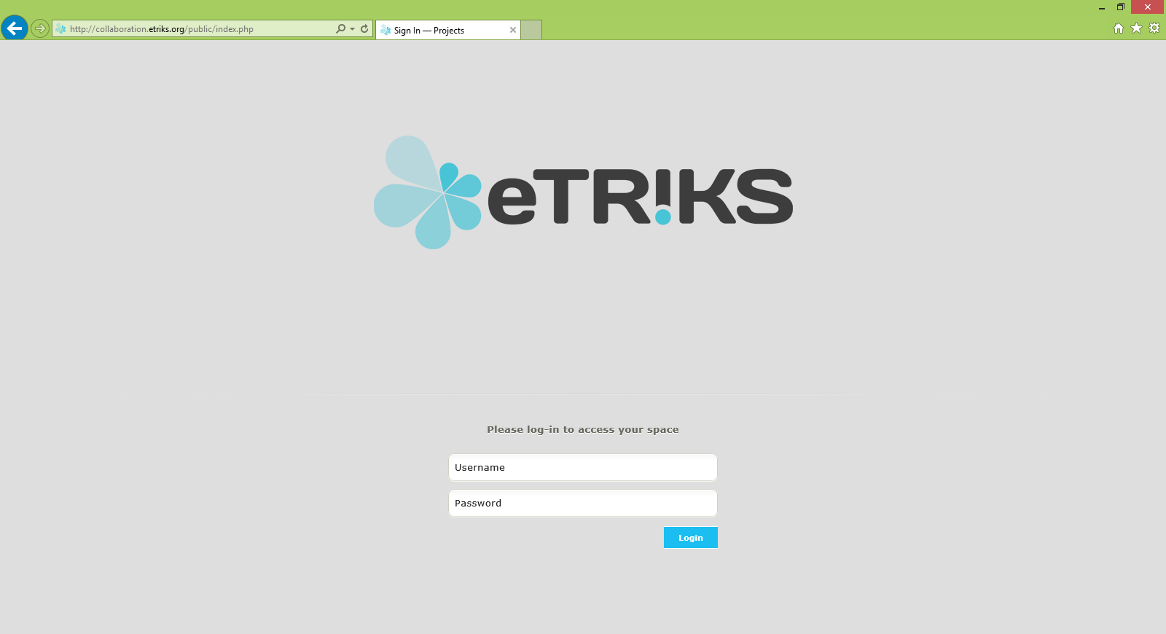
Logging in

Slide 27
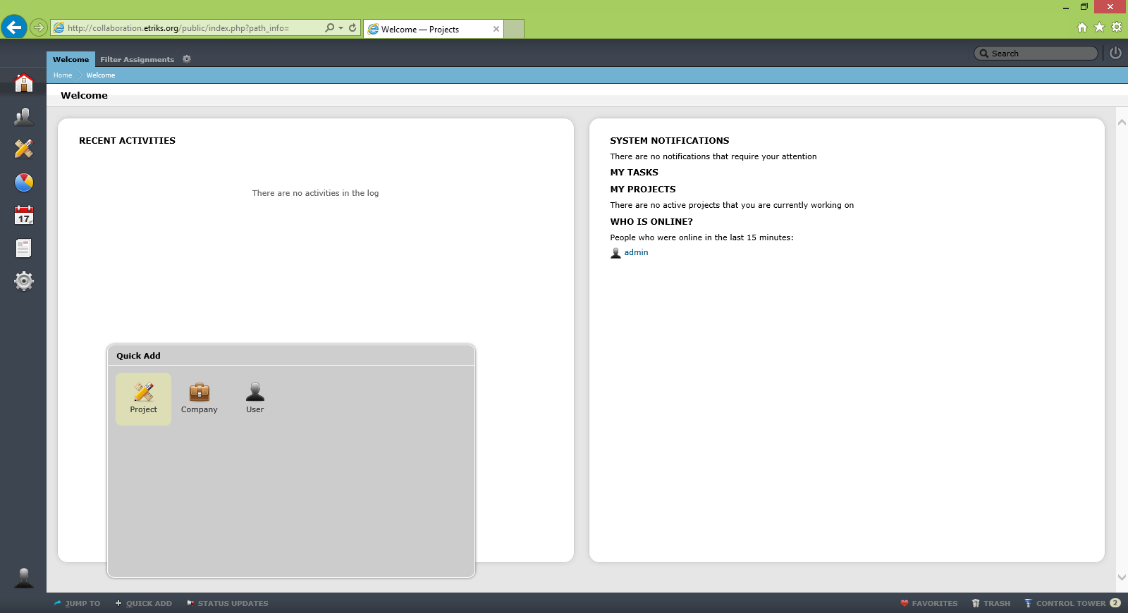
Create a Project

Slide 28
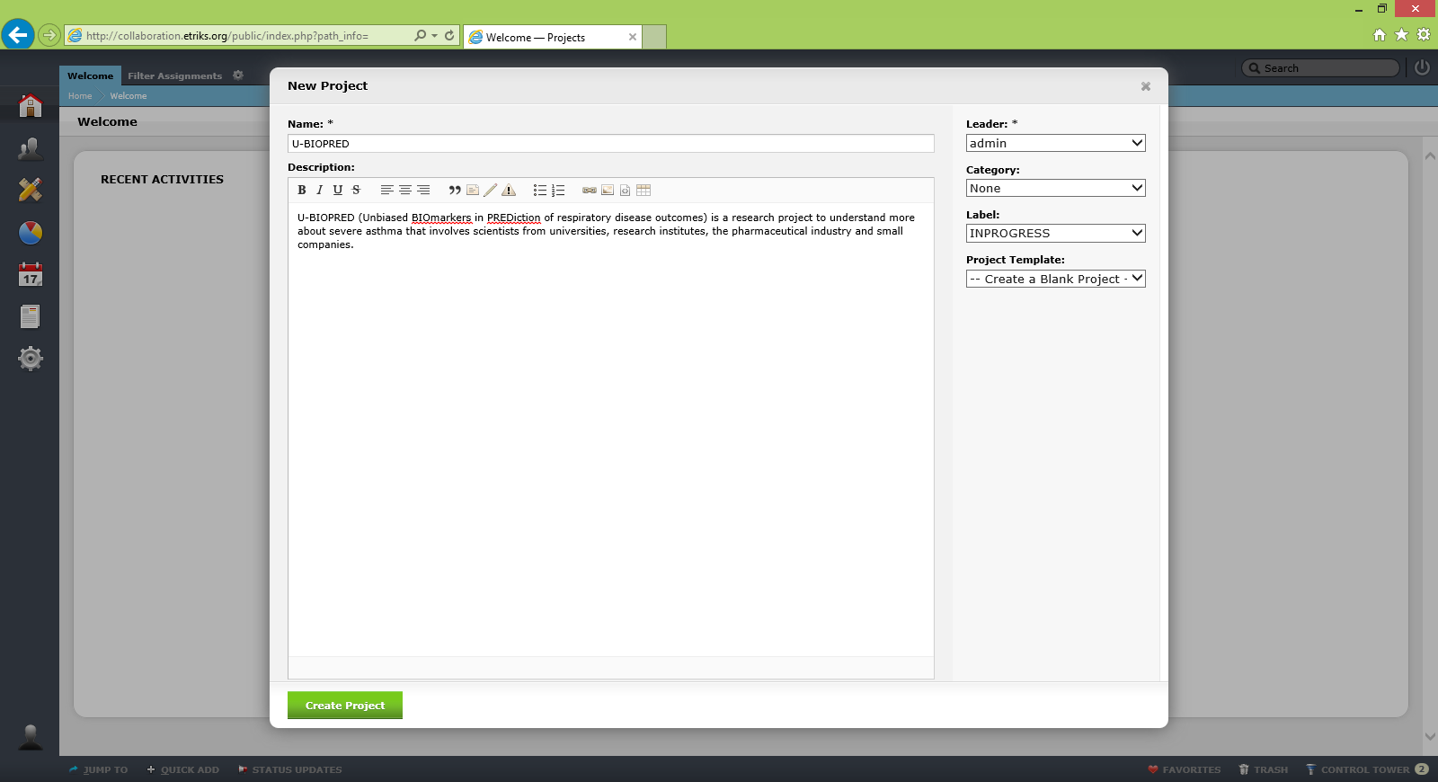
Create a Project

Slide 29
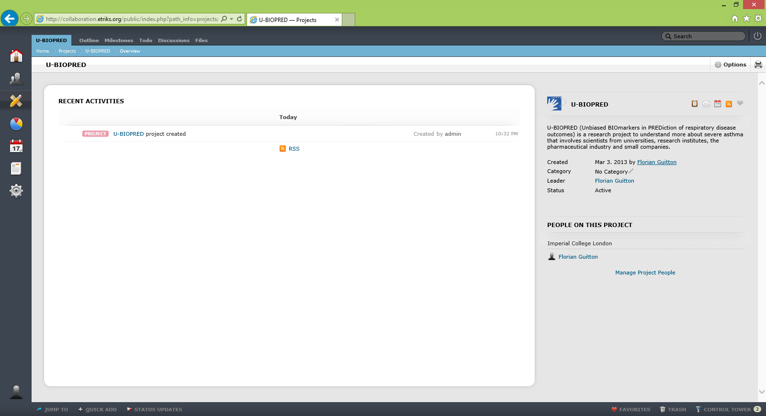
Create a Project

Slide 30
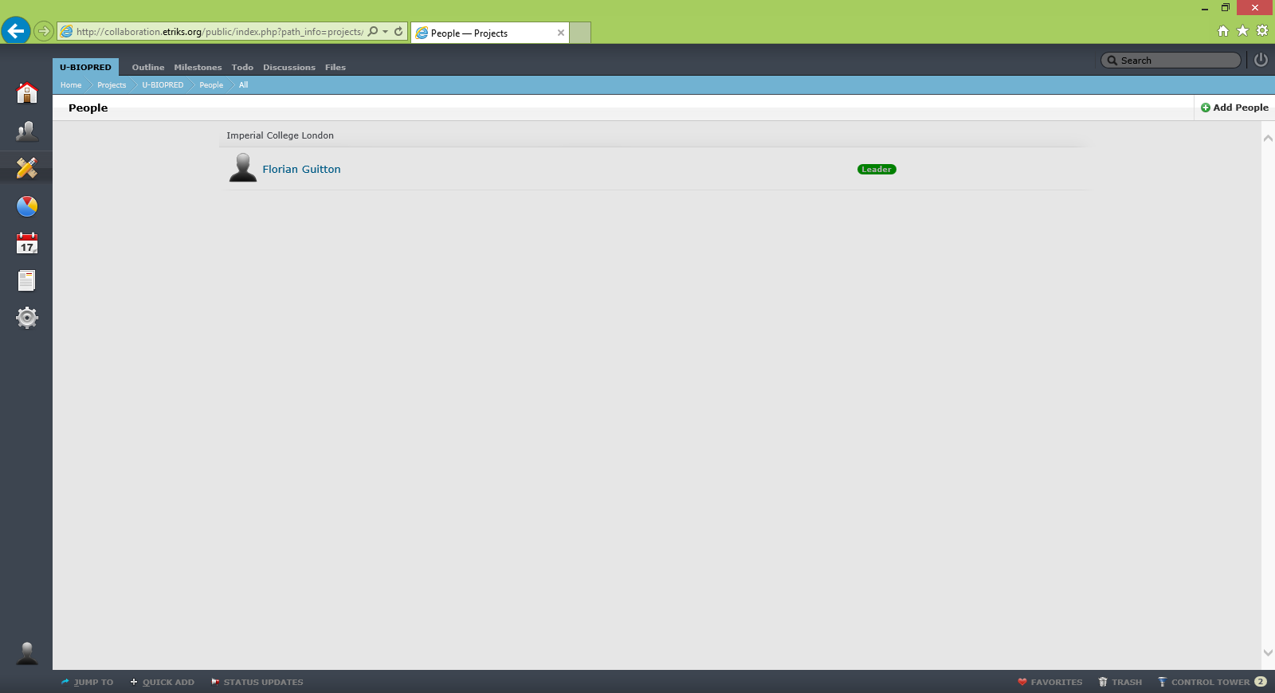
Add Members to the Project

Slide 31
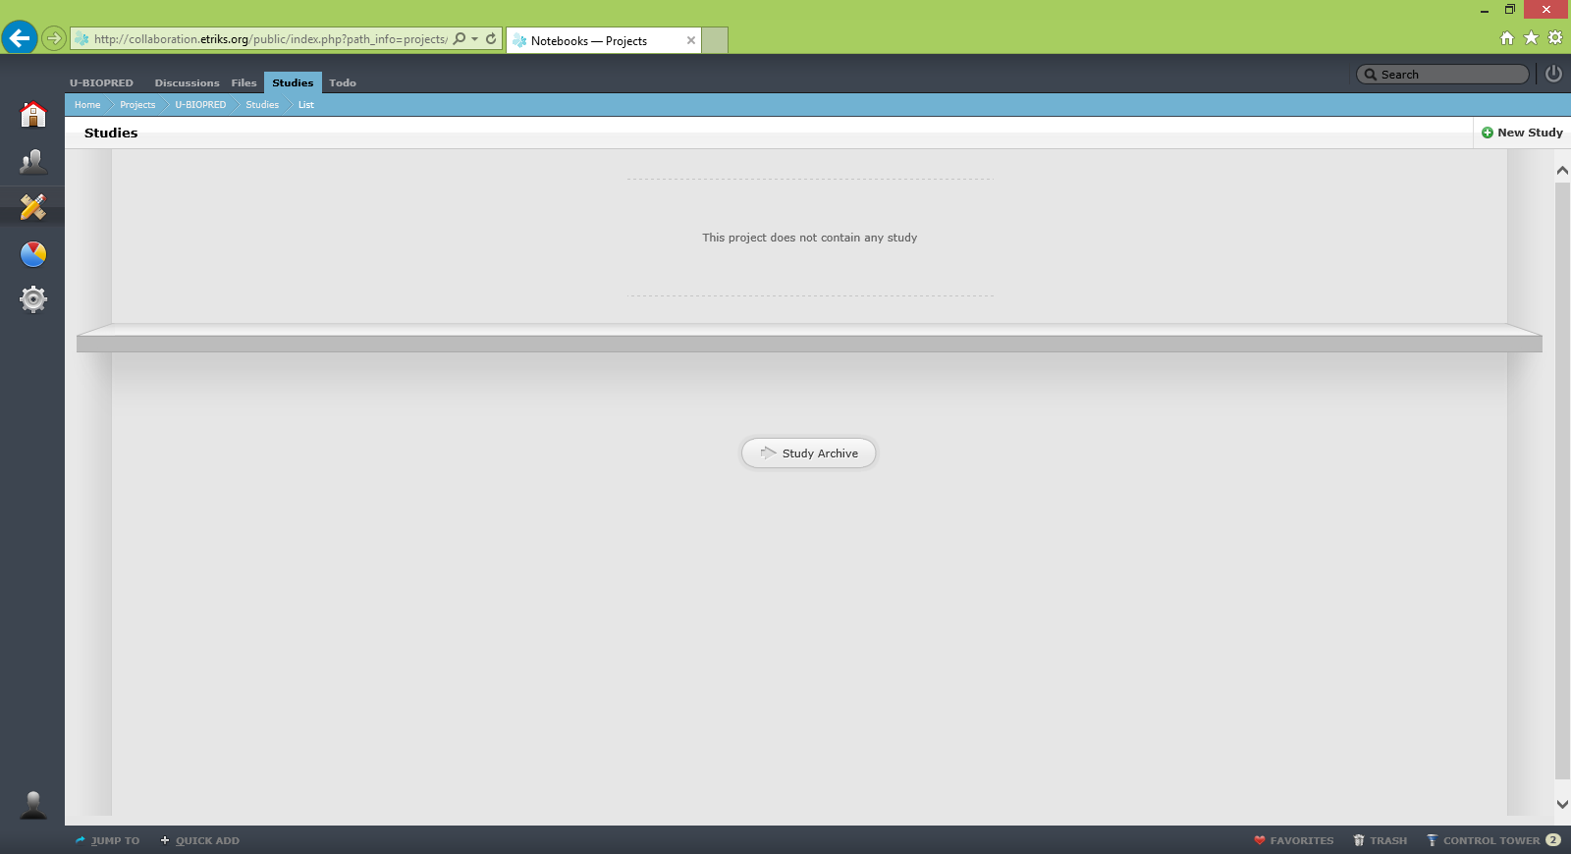
Create a Study

Slide 32
Create a Study

Slide 33
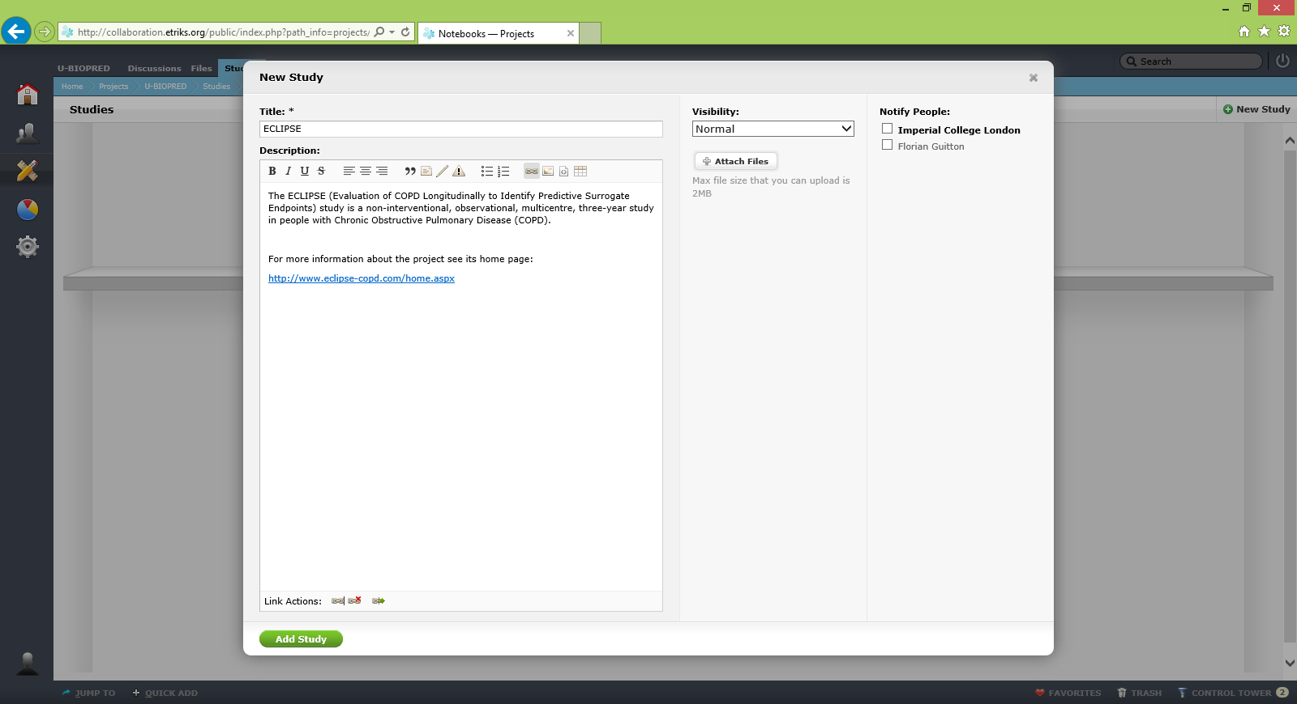
Create a Study

Slide 34
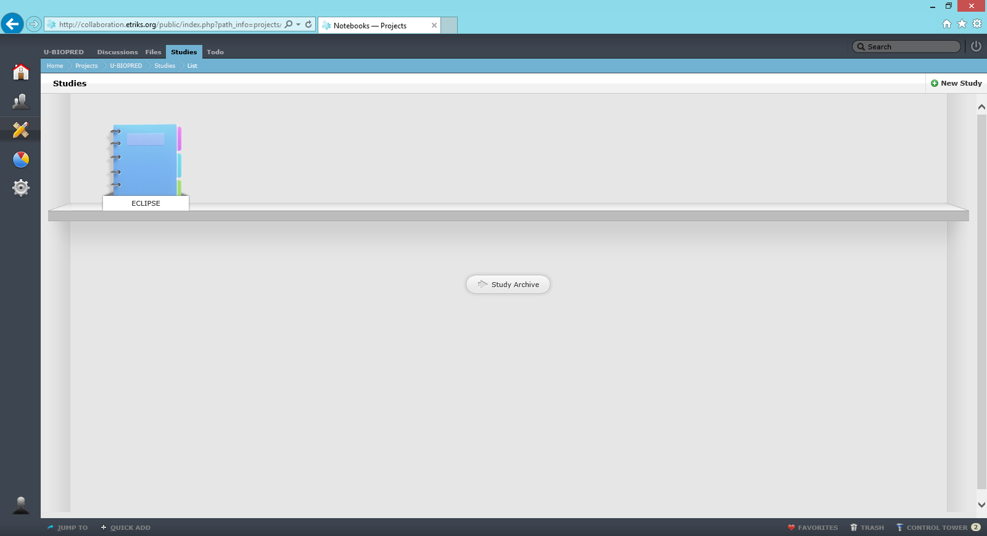
Create a Study

Slide 35
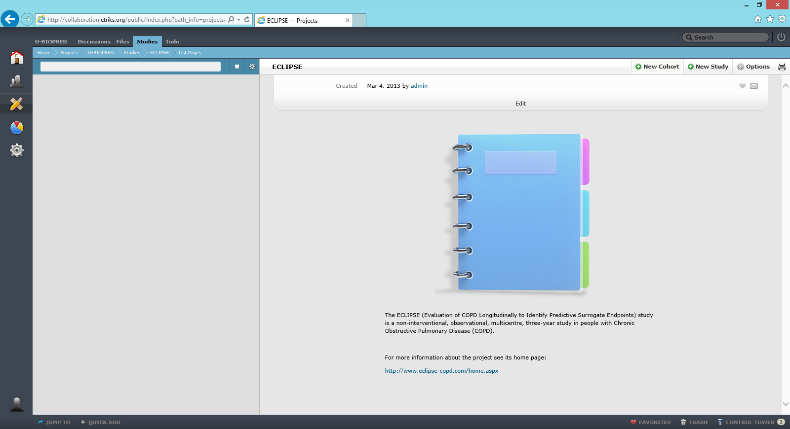
Create a Study

Slide 36
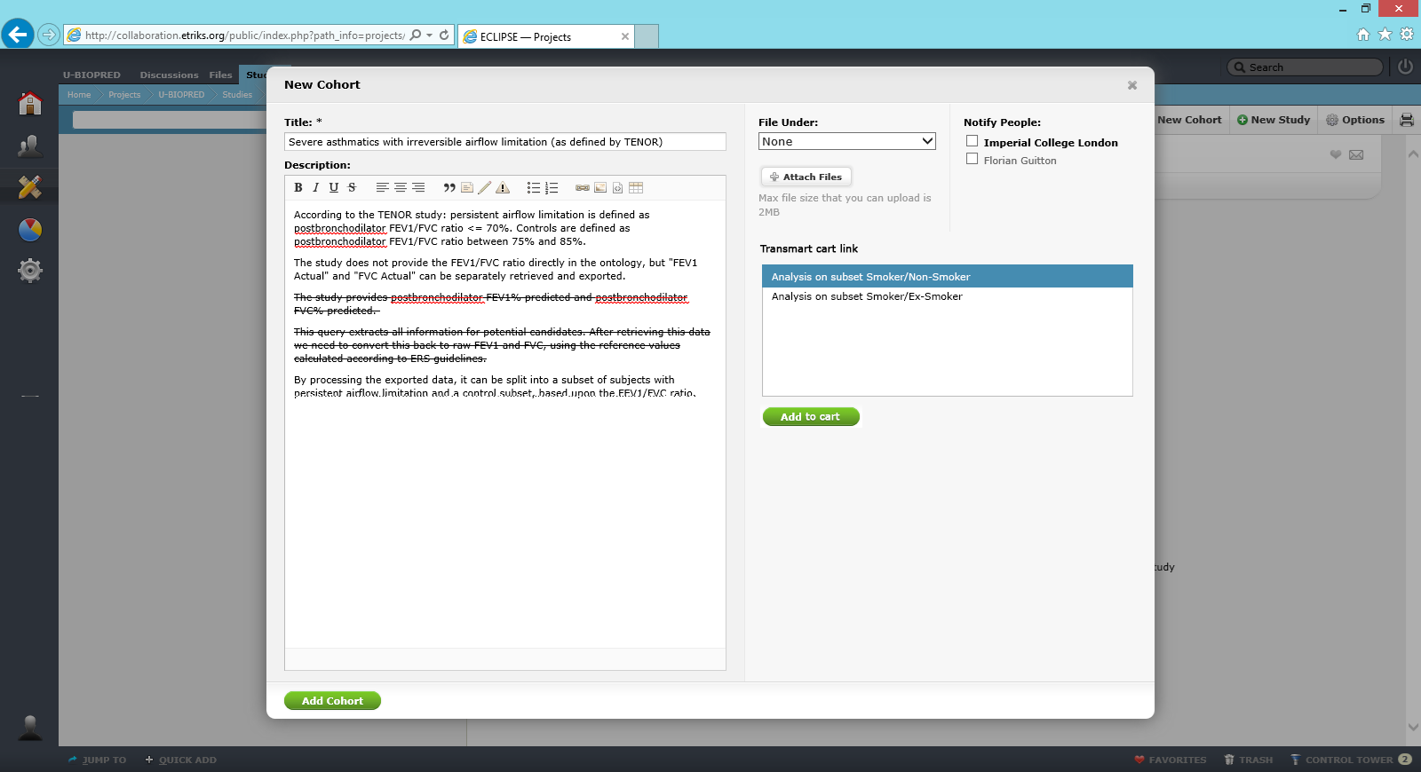
Create a Cohort

Slide 37
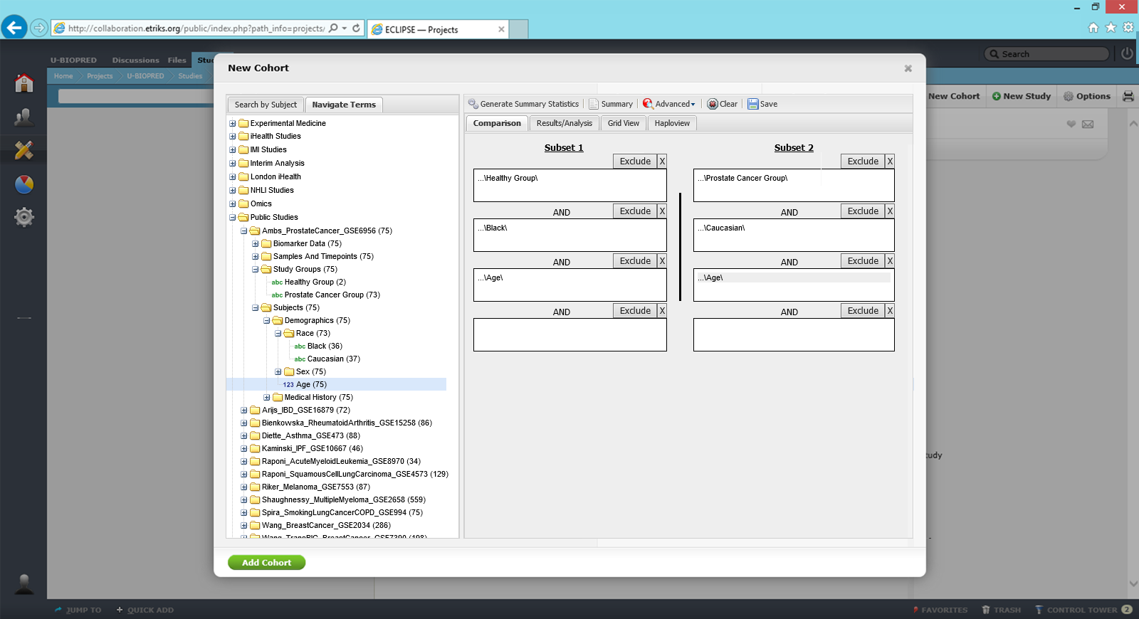
Create a Cohort

Slide 38
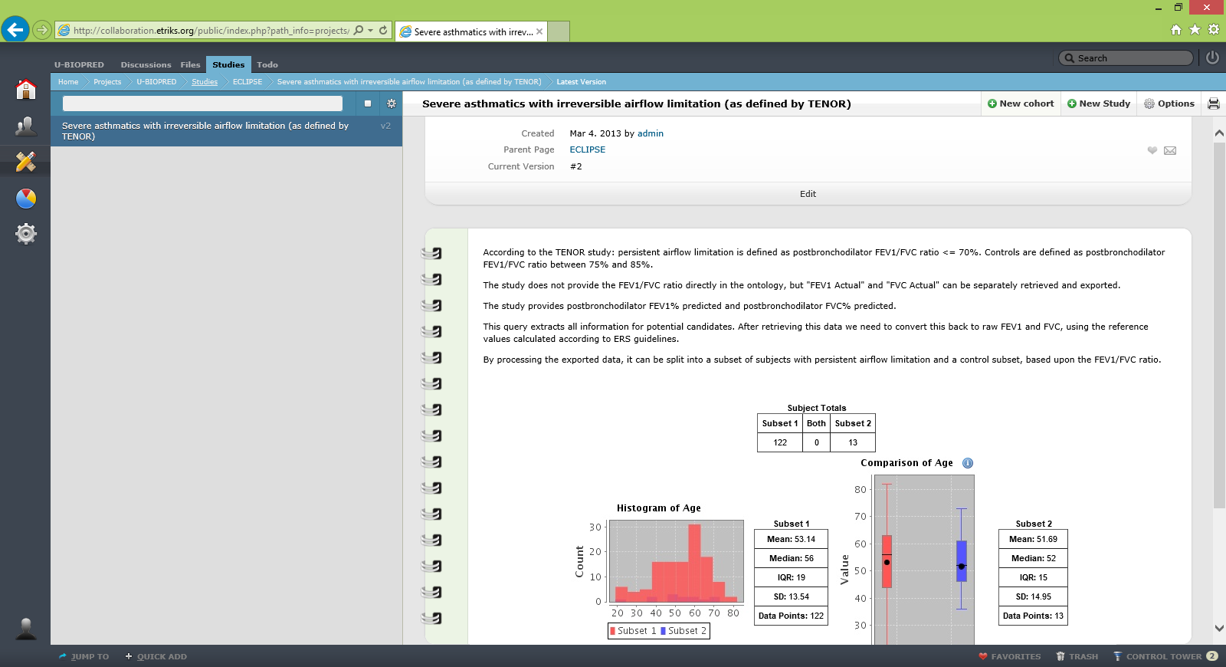
Create a Cohort

Slide 39
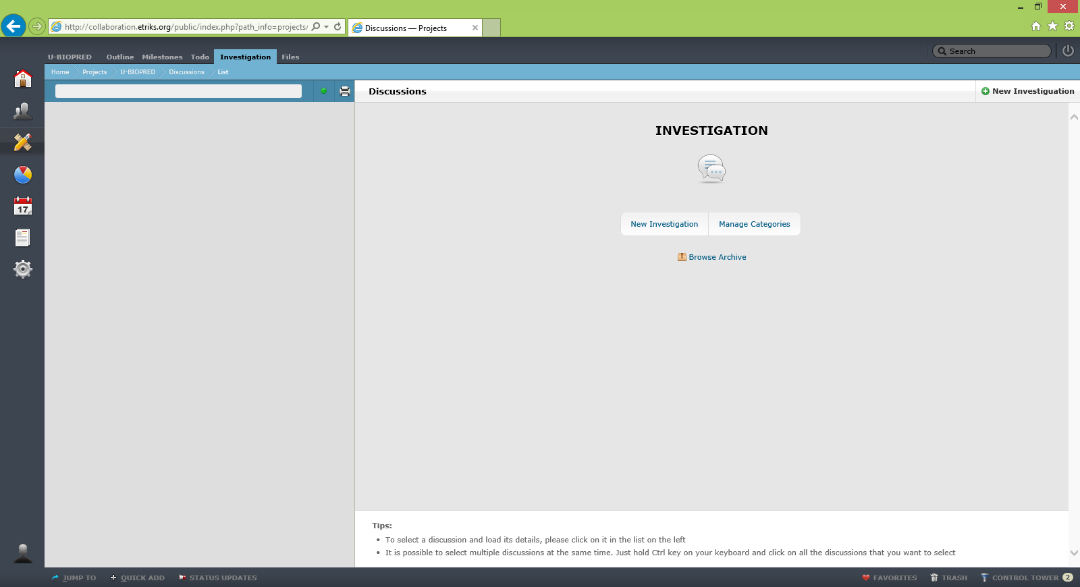
Create an Investigation

Slide 40
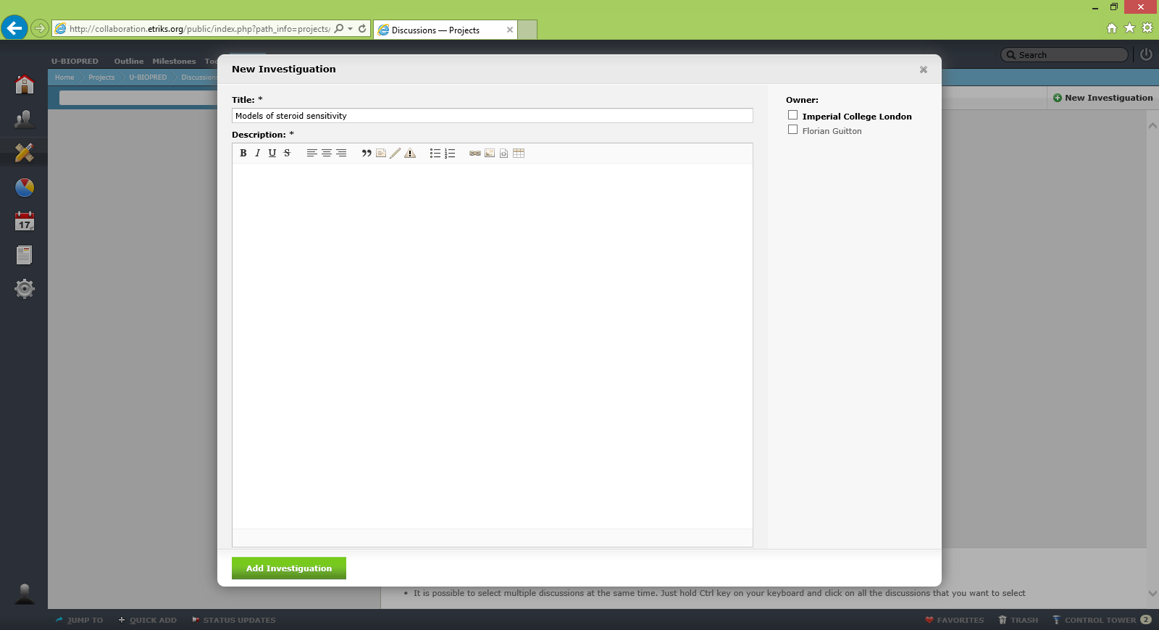
Create an Investigation

Slide 41
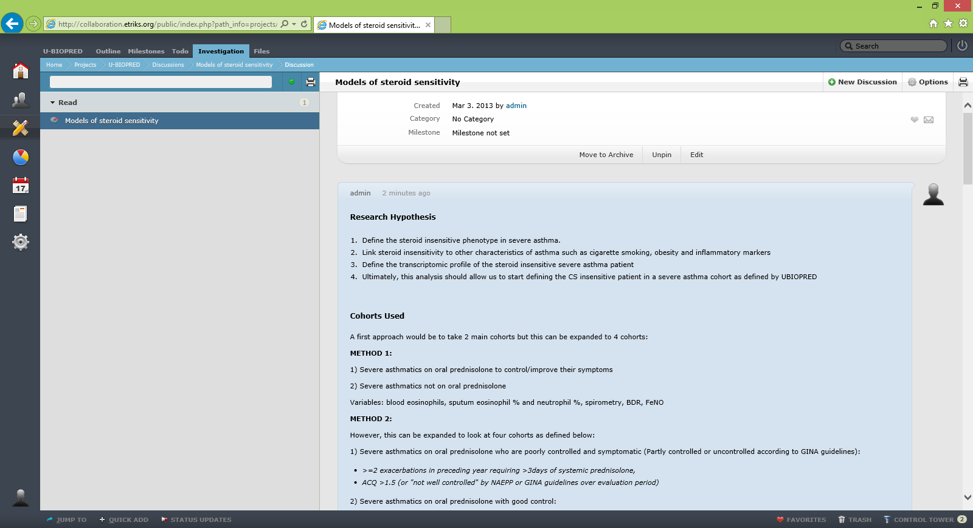
Collaborative Knowledge Production & Sharing

Slide 42
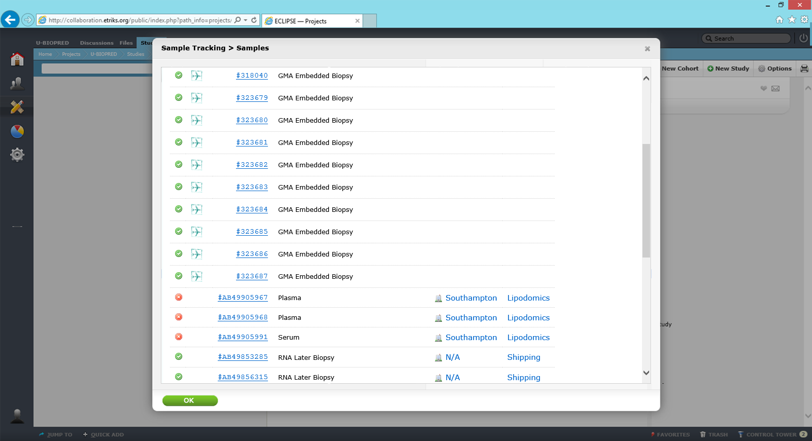
Sample Tracking capabilities

Slide 43
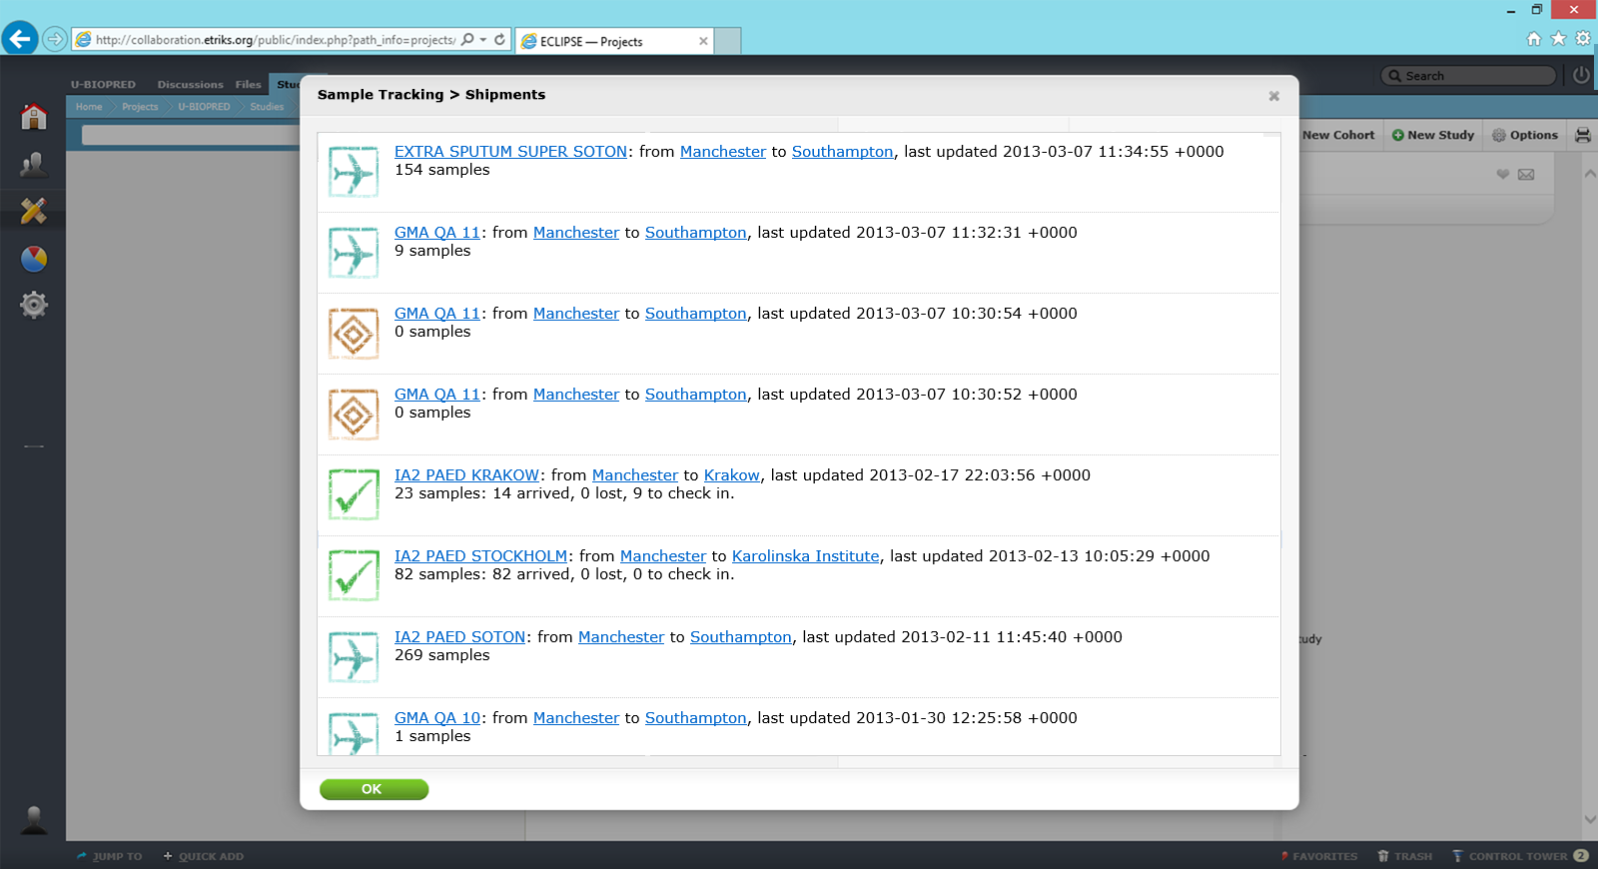
Sample Tracking capabilities

Slide 44
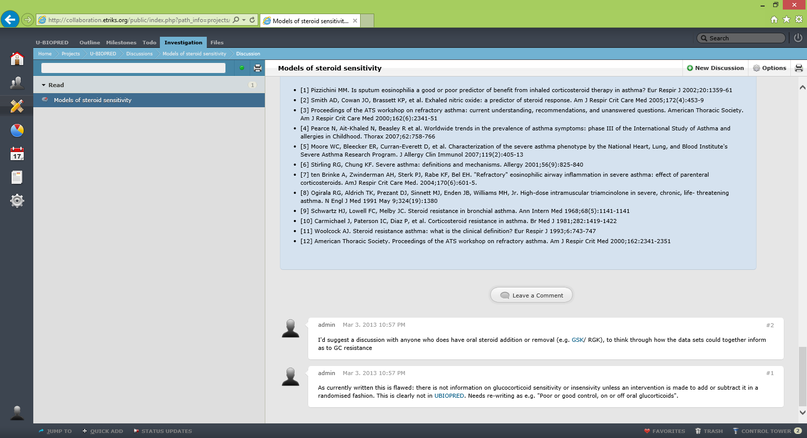
Collaborative Knowledge Production & Sharing

Slide 45
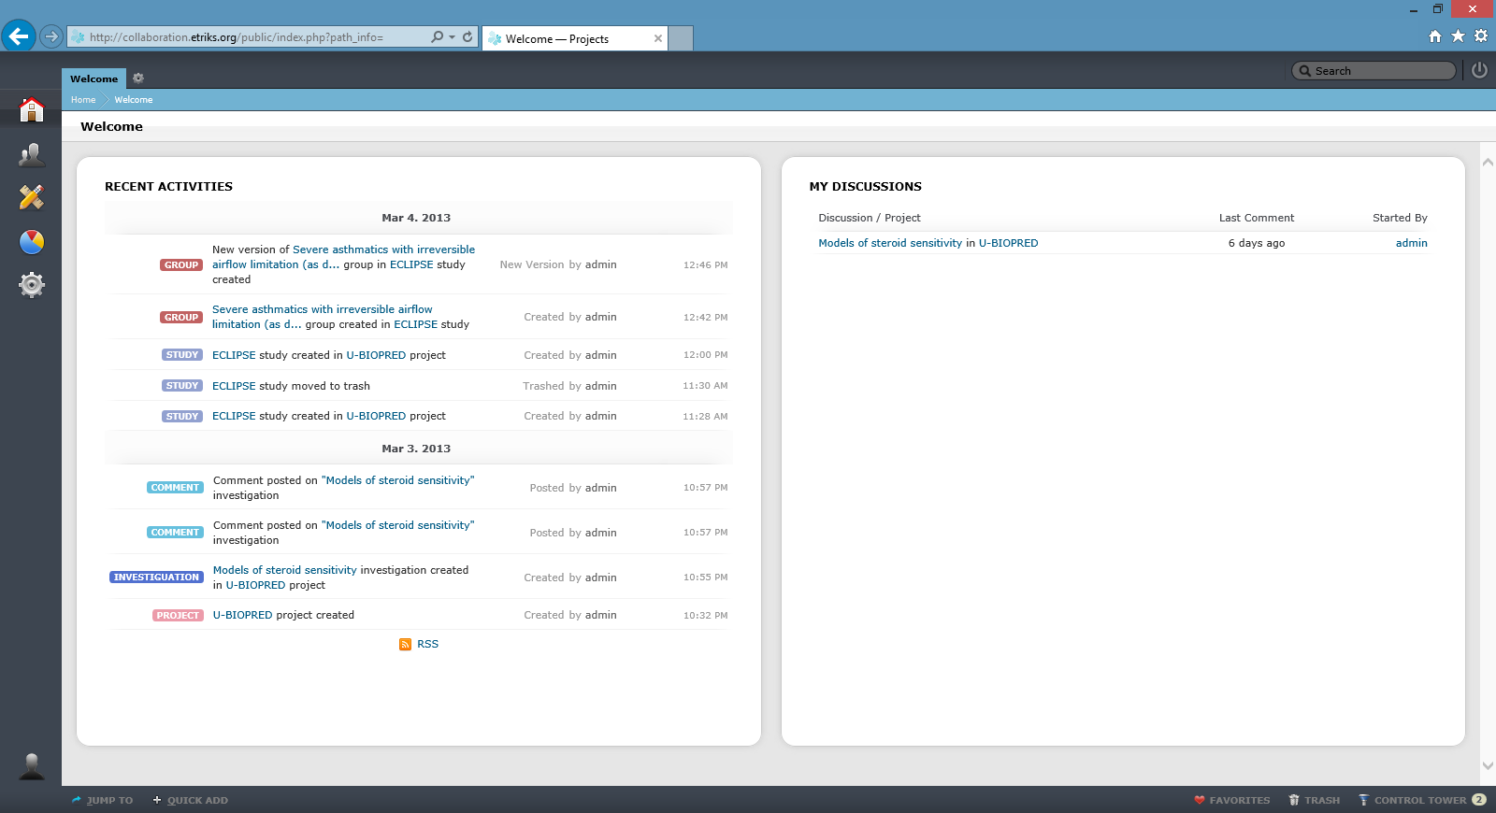
Collaborative Knowledge Awareness

