Slide 1
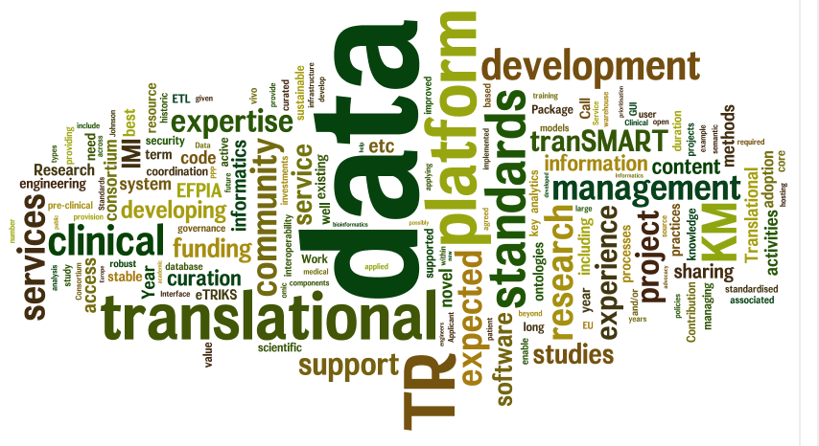

eTRIKS: European Translational Information and Knowledge Management Services
Prof. Yike Guo
Department of Computing
Imperial College London

Slide 2
Background …..

Slide 3
The IMI KM Challenge
~40 Safety and Efficacy Projects now generating or aggregating pre-clinical and clinical data for analysis, across many different disease areas.
    No common KM architecture or service in place to support pre-competitive (& competitive) cross-institute TR
    No public knowledge management system for curated TR data
  Inefficiencies for each project (cost)
  Redundancy in ‘local’ solutions
  Data legacy challenge post project
  Unnecessary complexity in downstream analytics (multiple standards)
  Fragmented bio-medical informatics community in IMI
  Reduced ROI for overall IMI investment
Requirement: IMI projects need access to a common stable, open KM platform and service for optimised execution.

Slide 4
Beyond IMI : Translational Research Requires KM Platform
Translational research is data rich in 3V ( volume, variety and velocity):
  need a big data management system
Translational research is analytics driven:
  need a powerful analytics platform
Translational research is inherently collaborative:
  need to support a virtual research organisation and workflow
Translational research is a knowledge enrichment process
  need to manage research hypothesis/results during a study process

Slide 5
2011: eTRIKS IMI Call process
(with 20m budget)
Create a Centre of Excellence for the management & analysis of Translational Study data:
Build on open source TR informatics system to create the required infrastructure
Support IMI (& other EU) TR Studies (Data loading, utilisation, training, awareness etc)
Research & Deploy new analytics methods and tools
Populate with existing public TR Study Data
Be explicit re consortia capabilities & skills: proven track record and experience in building production quality TR solution for large scale projects.

Slide 6
Imperial-led Bid : UBIOPRED KM Experience
U-BIOPRED: Unbiased Biomarkers for predicting respiratory disease outcomes
40 Party Collaboration between 10 Pharma & 30 Academic Medical Centres
Knowledge Management Work Package
Imperial, CNRS,
Knowledge Management Platform
--Imperial College & JnJ TranSMART
AZ, Roche, UCB, JnJ TranSMART

Slide 7
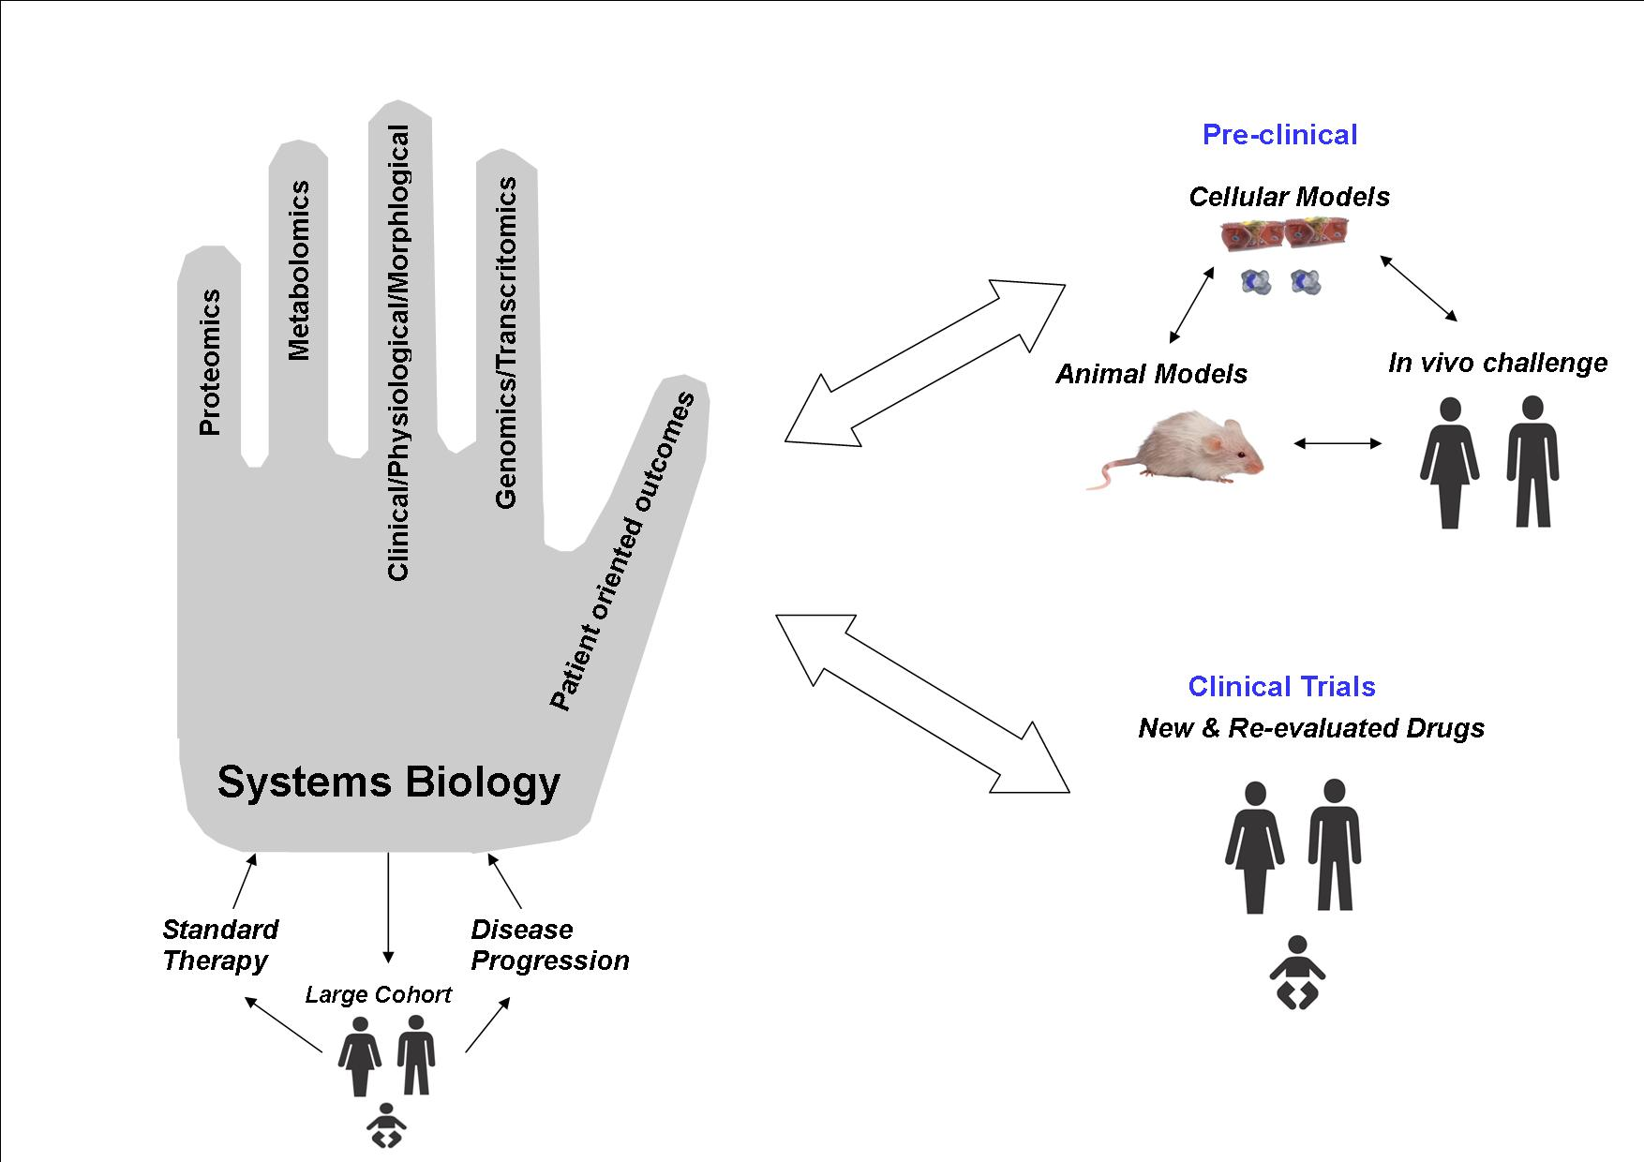
UBIOPRED Knowledge Product :
Handprints
Reaching international consensus on diagnostic criteria
Creating adult/pediatric cohorts and biobanks
Creating novel biology ‘handprints’ by combining molecular, histological, clinical and patient-reported data
Validating such ‘handprints’ in relation to exacerbations and disease progression
Refining the ‘handprints’ by using preclinical and human exacerbation models
Predicting efficacy of gold-standard and novel interventions
Refining the diagnostic criteria and phenotypes
Establishing a platform for exchange, eduction and dissemination

Slide 8
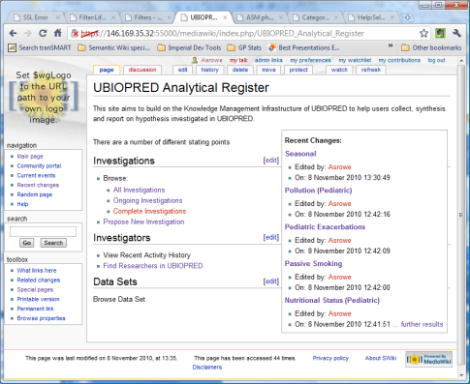
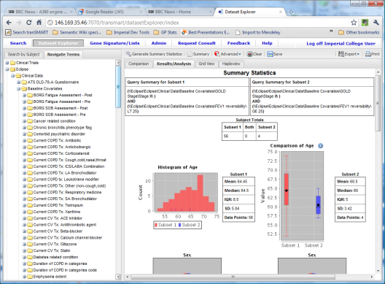
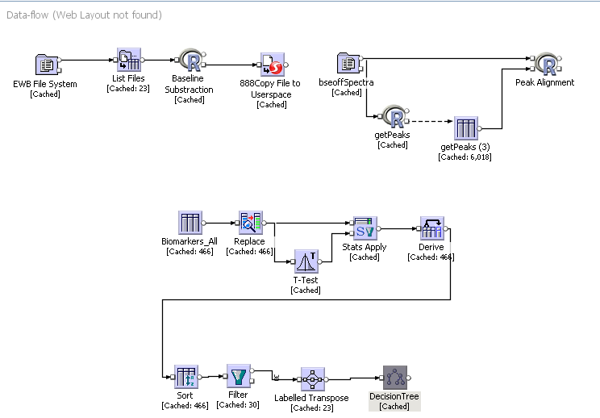
UBIOPRED Collaborative TR Platform
Analytical Register :
Research Collaboration
Management
TranSMART:
Cohort-based Omics Data Management
Analytical Workflow Engine
TSmart DB
Sample Tracking
Gene Pattern&R
Analytical Registry
EWB for Assay Data Management
InforSense
KDE Workflow
Virtual Machines
IC Cloud (Virtualisation Layer)
Physical Layer (Imperial Based Data Centre)

Slide 9
Imperial-led Bid Funded
KM support for IMI (and other PPP) projects
  Access to fit-for-purpose, secure, easy-access, standardised TR KM services (for ongoing cross-organisation TR study support)
    Hosting / installation
    Training
    Curation workflow software
    Data Mgmt software
  Single point of access to curated historic TR study data on the cloud
  Sustainable, interoperable, collaborative, re-usable, open source TR platform, based on open, agreed standards, used and contributed to by global research community.
Development of an active TR analytics & informatics community
    Analytics software
    Curation support
    Standards build and coordination
    KM consultancy
TR Informatics Standard and Centralized Data Cloud

Slide 10
Project Overview ……

Slide 11
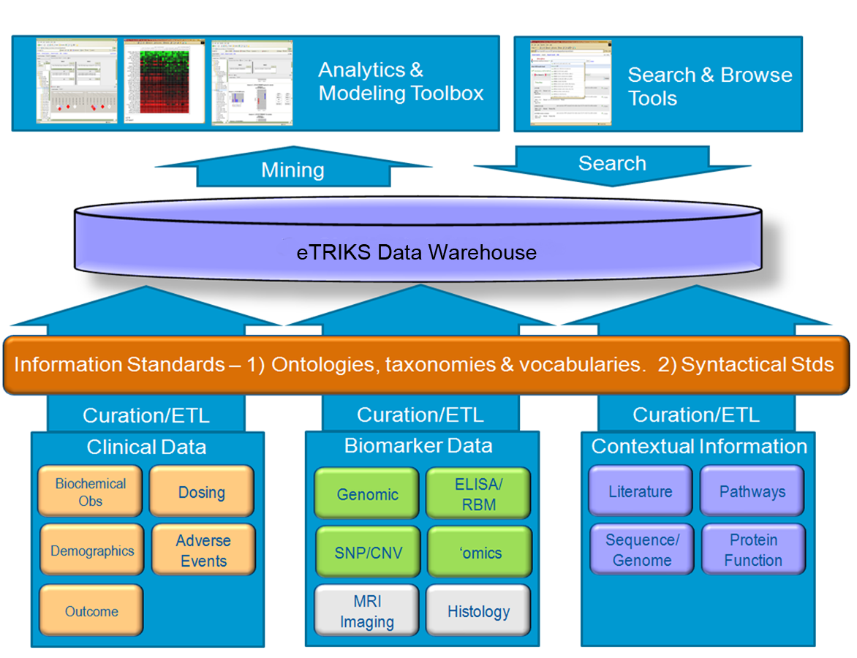
What is eTRIKS
IMI Round 4 Project: eTRIKS
Objective:
  Provision of a sustainable KM Platform and Service to support Private/Public Translational Research (TR) in IMI and beyond
  Single access point to standardised curated TR study information
Scope:
  Cloud Hosting, KM Platform, Data & Service Standards, Analytics, Curation, and Training
Members:
  10 Pharma
  6 Academic/Commercial Suppliers
  IC lead
Budget: €23.98m for 5 years (Oct/2012---Sept/2017)

Slide 12
The eTRIKS Team
‘Delivering eTRIKS’ Consortium selected by Expert Panel
Company | Name
ASTRAZENECA (Lead) | Ian Dix
 | Anne Westcott
 | Chris Marshall
JANSSEN (Deputy) | Anthony Rowe
 | Sandor Szalma
 | Greg Leibfreid
ROCHE | Michael Braxenthaler
GLAXOSMITHKLINE | Philippe Sanseau
 | Chris Larminie
SANOFI-AVENTIS | Manfred Hendlich
 | David Peyruc
BAYER | David Henderson
MERCK KGAA | Fabien Richard
 | Matilda Leung
PFIZER | Christoph Brockel
 | Jay Bergeron
LUNDBECK | Claus Stie Kallesøe
 | Birgitte Søgaard
 | Jennifer Larsen
LILLY | Hans Constandt
 | Derek Marren
10 Companies
Organisation | Name
Imperial College | Yike Guo
 | Duncan Gillies
 | Daniel Ruekel
CNRS | Charles Auffray
 | Rolf Rumler
 | Dominique Boutigny
Uni Luxembourg | Rudi Balling
 | Reinhard Schneider
 | Antonio del Sol
IDBS | Robin Munro
BioSci | Scott Wagers
CDISC | Bron Kisler
 | Rebecca Kush
6 Organisations

Slide 13
eTRIKS Work Packages

Slide 14
Work Package Objectives Summary
Work Package | Objectives
WP 1 - Platform Service Delivery | Establish a stable permanently accessible technical base for eTRIKS Provide eTRIKS platform to the IMI users Offer pertinent support to eTRIKS user and development community
WP 2 - Platform Development | Develop a scalable, secure and reliable KM platform Research and develop new functionalities/data types for the requirements of IMI projects Support eTRIKS-based Application building by publishing and maintaining system APIs Establish a quality software engineering support and a governance structure for eTRIKS platform development
WP 3 - Standards Research and Coordination | Adopt community agreed information and data standards. Establish and maintain interactions with IMI & non-IMI translational projects regarding their data. Enable eTRIKS users to easily adopt and adhere to a worldwide network of open global standardised data. Provide support and training for the adherence of standards.
WP 4 - Analytics Research & Content Curation | Curation and annotation of historic studies as well as active studies and loading them into the system. Development of Translational Research analytics, algorithms, GUIs and workflows based on the specific needs of IMI projects and EFPIA members.

Slide 15
Work Package Objectives Summary
Work Package | Objectives
WP 5 - Governance and Business Model | Create a governance environment for eTRIKS that will ensure the delivery of a valued, sustainable environment for the management of Translation Research Monitoring and tracking the deliveries and resources for eTRIKS Implement a robust, long term sustainable business model to manage the affairs and environment of eTRIKS
WP 6 - Community Engagement & Outreach | Develop and maintain eTRIKS website and outreach material. Establish and maintain interactions with IMI & non-IMI translational projects Provide education to IMI and non-IMI translational scientists, patient advocacy groups, commercial service providers regarding the mission and services of the eTRIKS consortium.
WP 7 - Ethics for eTRIKS platform data | Identify and define the legal, security and privacy requirements of the eTRIKS project. Ensure that storage, access and processing of data in eTRIKSis in compliance with national/ European/international legislation Identify and co-ordinate with the ethics workgroups of other IMI projects working with patient data that will be used by eTRIKS.

Slide 16
eTRIKS Delieverable
Platform: Building on open source TranSMART system a KM platform for collaborative KM for IMI translational projects
Services: Support for IMI (& other EU) TR Studies re KM data services
  TR project KM consultation, curation support, historic data curation
  Platform maintenance, enhancements & code control
  Administration, exploitation support, training, awareness
Content: Populate with existing and active TR Study Data
  Clinical Study Data
  Pre-Clinical Study Data (e.g. in vivo)
  Biomarker data associated with Studies: ‘omics, genetic, NGS, etc.
  Background knowledge (e.g. molecular pathway data, literature)
Standards: Development and adoption of TR information standards
Research: Research & Development of new analytics methods and tools

Slide 17
Platform……

Slide 18
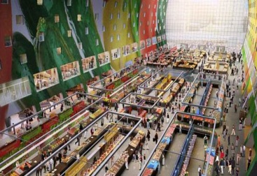
eTRIKS Platform
Collaboration Platform
Supporting collaboration
Supporting research process
Analytics Marketplace
Access to the world’s most advanced analytics tools
Open API allows both open source and proprietary application software to plug-in
TR Data Hub
Infrastructure for TR data management
Curation support for content building
Supporting IP capturing and management
Liking data with expertise for analysis
Data integration support
Secure data sharing

Slide 19
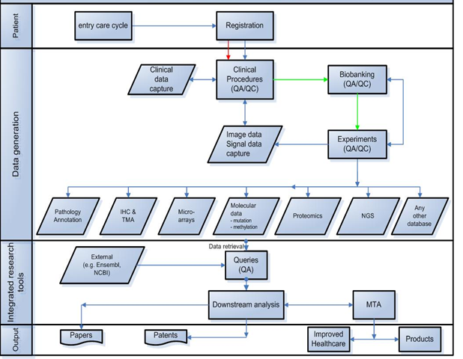
eTRIKS Supported TR Workflow

Slide 20



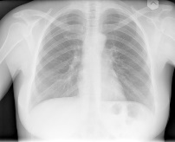



eTRIKS Data Integration
Ethics
data domains
HIS
clinical
Study Data
Management
Analytics
Workbenches
e.g. Open
Clinica
PACS
imaging
e.g.
BMIA
LIMS
Pseudonymisation
biobanking
e.g.
CBM
e.g. R
BIMS
experiment
Various
solutions

Slide 21
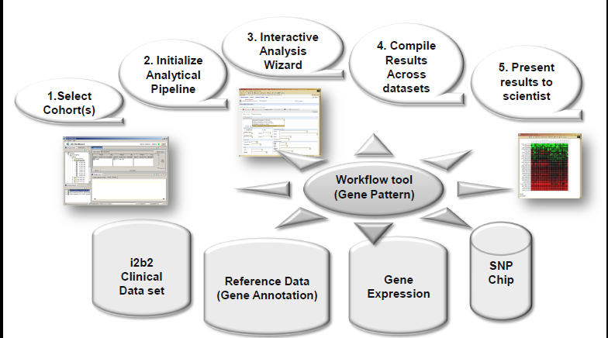
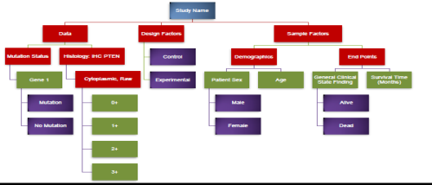
eTRIKS Study Data Organisation
Study oriented curated data together with patient information are integrated and warehoused in tranSMART for analysis

Slide 22
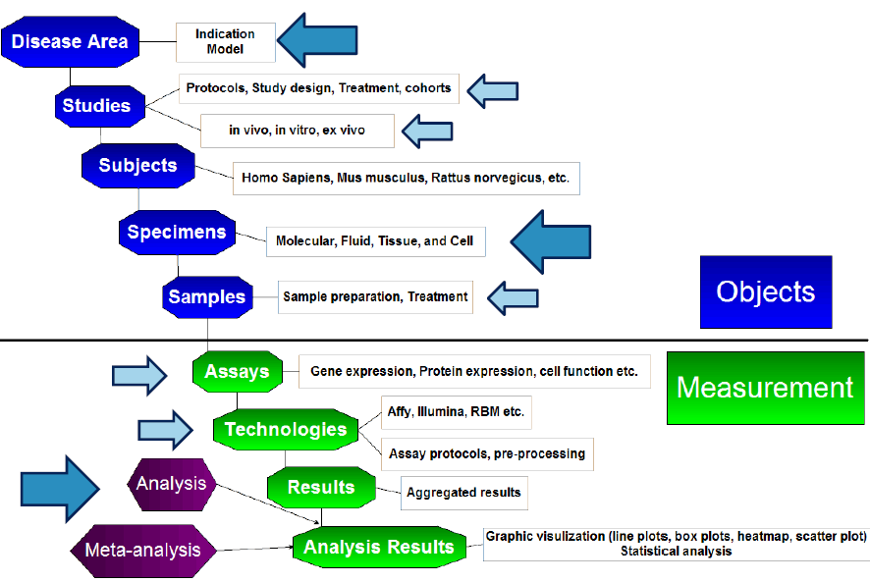
eTRIKS Study Information Content

Slide 23
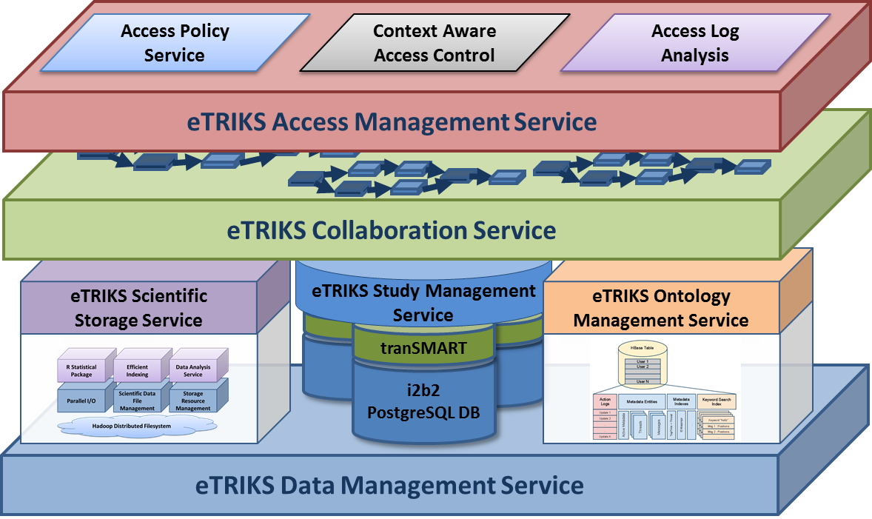
eTRIKS Platform Architecture
Based entirely on open source software
Support project-level multi-tenancy

Slide 24
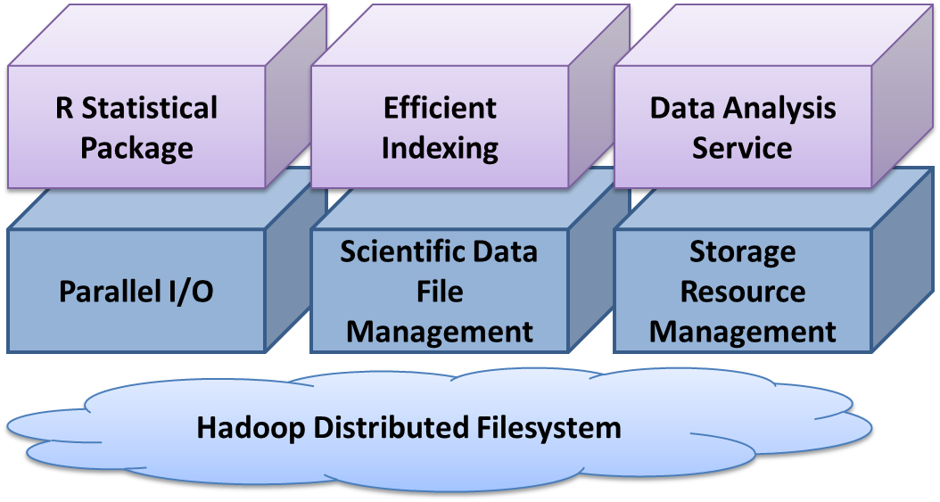
eTRIKS File System for Experiment Data Management

Slide 25
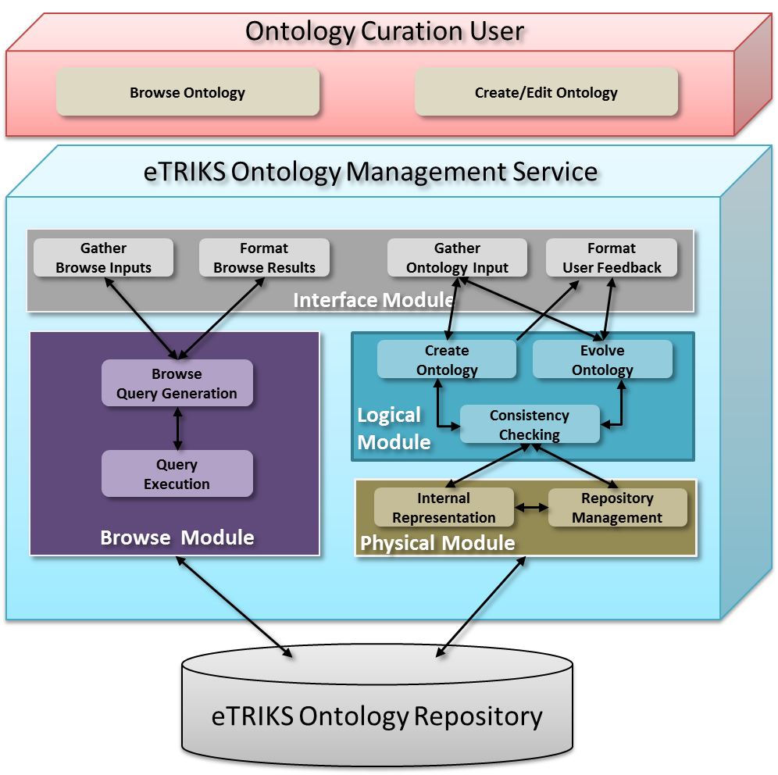
eTRIKS Ontology Management

Slide 26
An Example …..

Slide 27
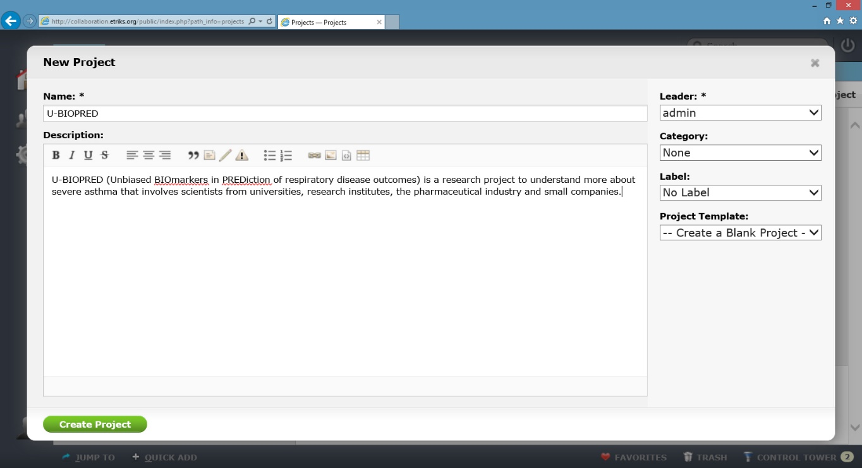
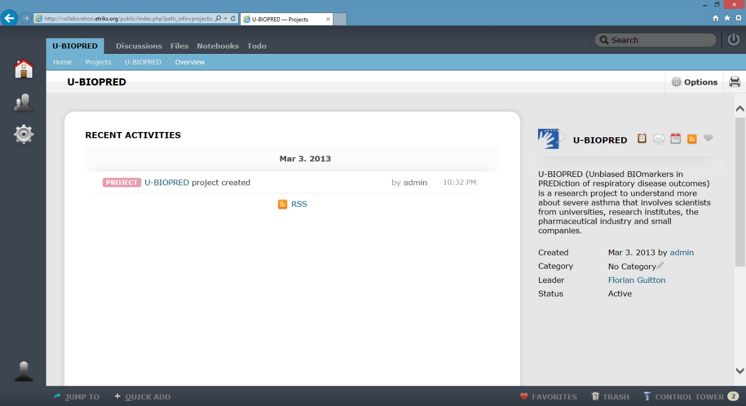
Create a Project
We first create the project workspace on the eTRIKS platform

Slide 28
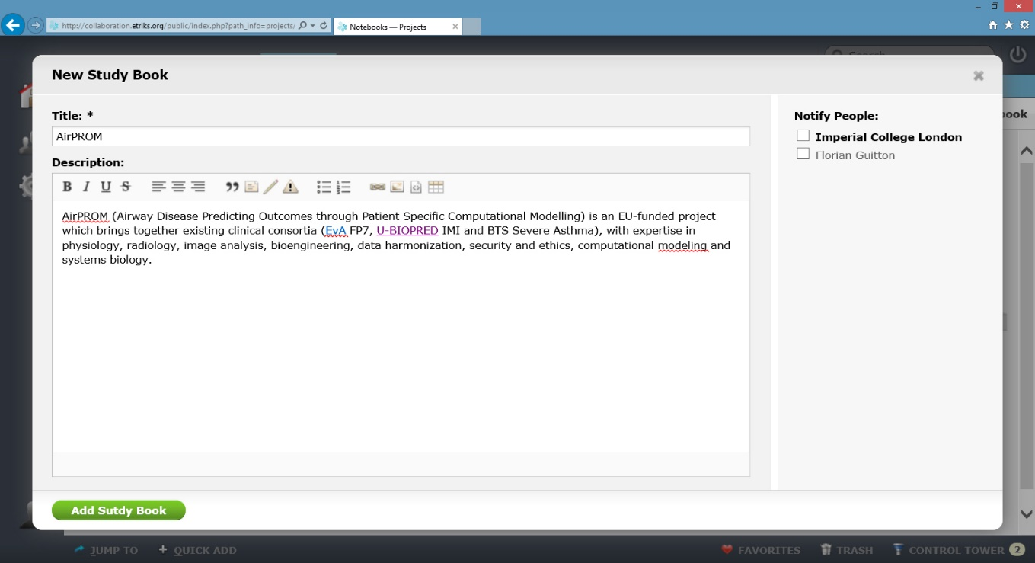
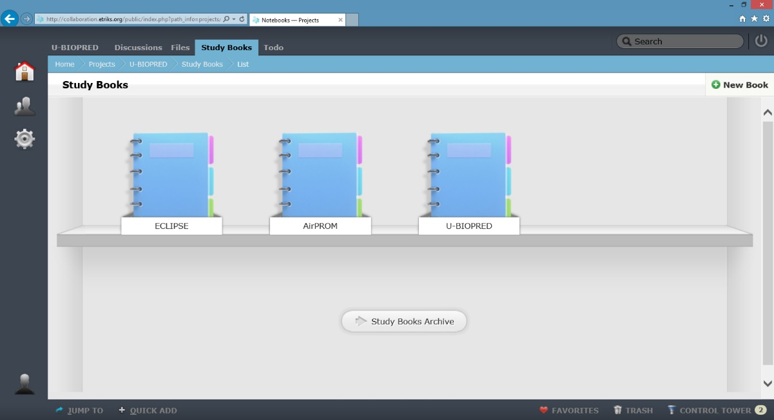
Create a Study Book
Each study book is represented via an icon. We can access the study by clicking on it
We create a study book in the project

Slide 29
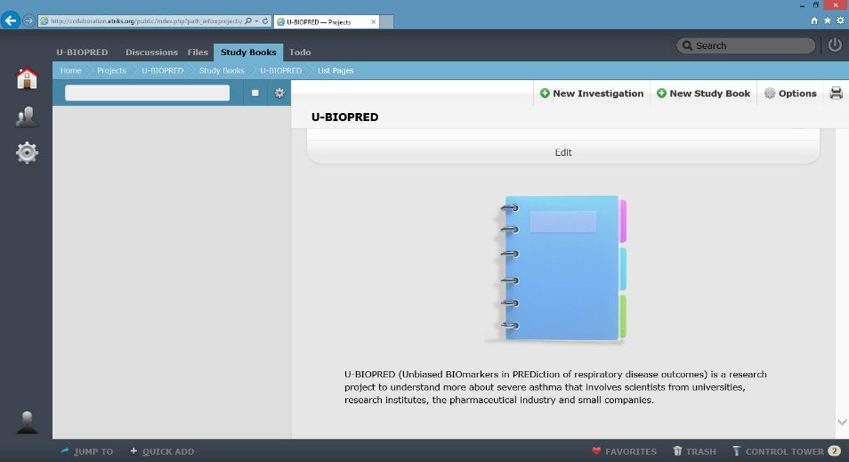
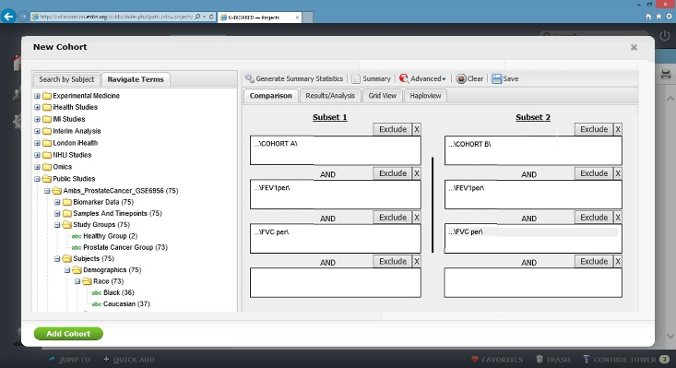
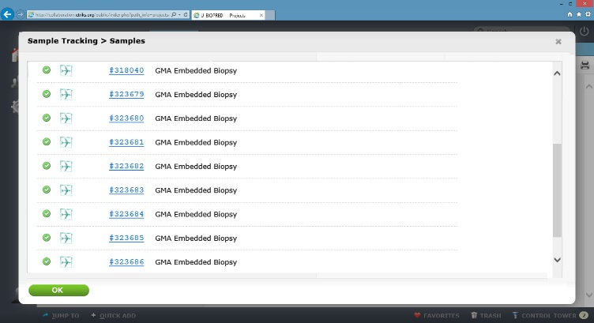
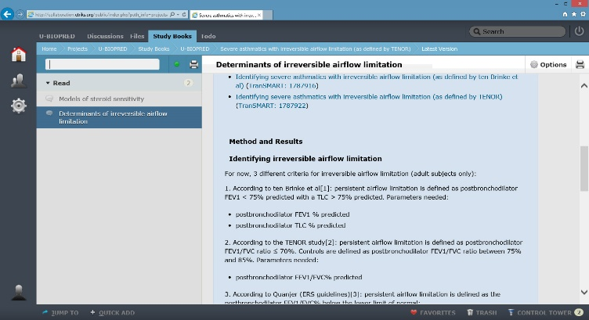
Study space
The study book allow the managment of cohorts, investigations, samples, etc …
Cohort
Samples
Investigation

Slide 30
Analysis process
Aim: Defining clinical features and biomarkers that determine whether a severe asthmatic will develop irreversible airflow limitation.
Available samples: 239 samples
  Cohort A (severe asthmatics): 30
  Cohort C (mild/moderate asthmatics): 19
  Cohort D (healthy people): 10

Slide 31
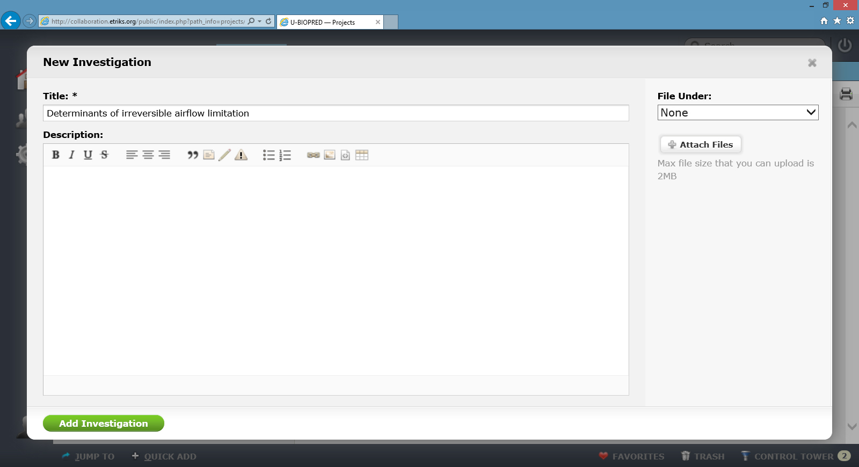
Create an Investigation
We generate an hypothesis
in the study space
Identifying irreversible airflow limitation
For now, 3 different criteria for irreversible airflow limitation (adult subjects only):
  1. According to ten Brinke et al[1]: persistent airflow limitation is defined as postbronchodilator FEV1 < 75% predicted with a TLC > 75% predicted. Parameters needed: • postbronchodilator FEV1 % predicted
  • postbronchodilator TLC % predicted
  2. According to the TENOR study[2]: persistent airflow limitation is defined as postbronchodilator FEV1/FVC ratio ≤ 70%. Controls are defined as postbronchodilator FEV1/FVC ratio between 75% and 85%. Parameters needed: • postbronchodilator FEV1/FVC% predicted
  3. According to Quanjer (ERS guidelines)[3]: persistent airflow limitation is defined as the

Slide 32
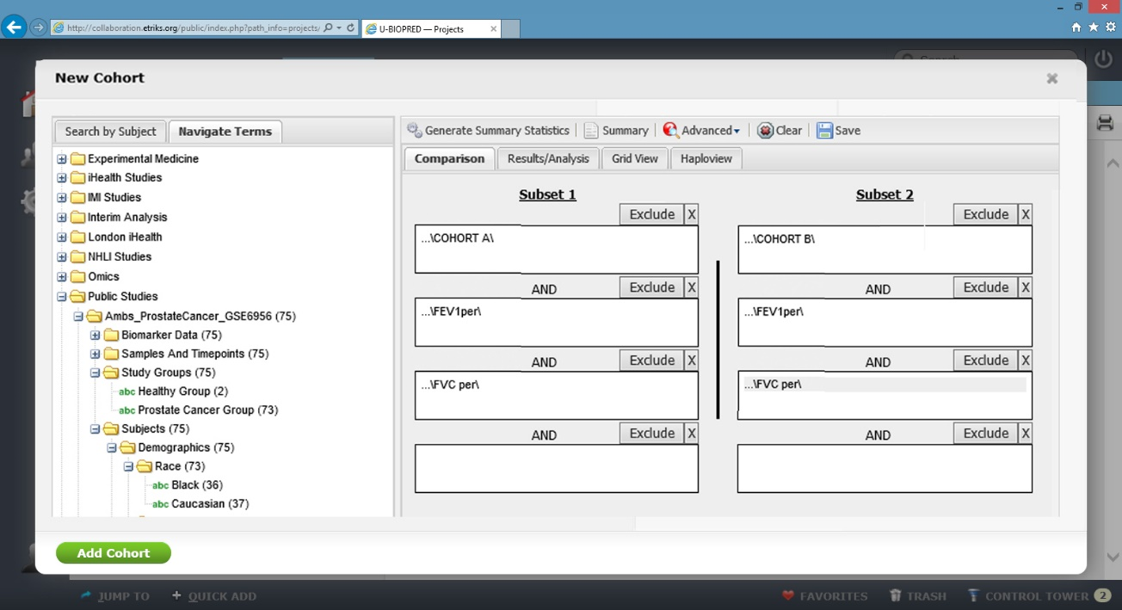
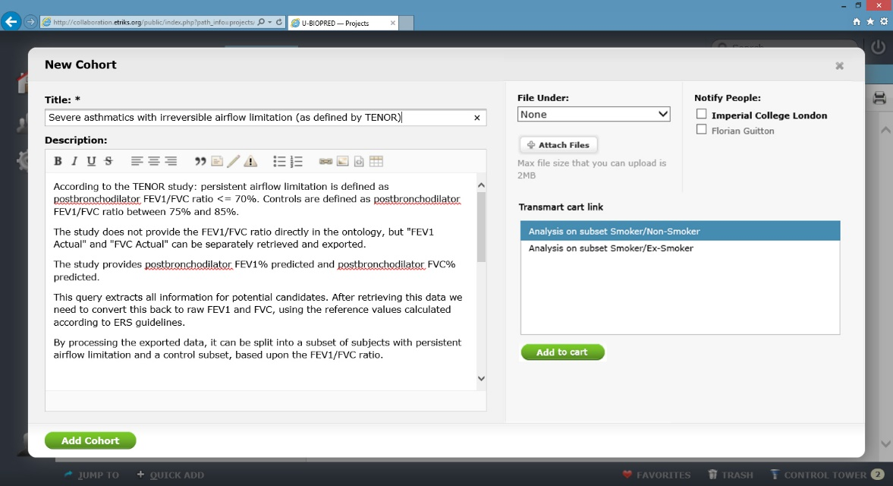
Create related Cohort
We build a cohort via defining conditions:
    Subset 1: Study Group = Cohort(A) AND FEV1 (Day 1) AND FVC (Day 1)
    Subset 1: Study Group = Cohort(B) AND FEV1 (Day 1) AND FVC (Day 1)

Slide 33
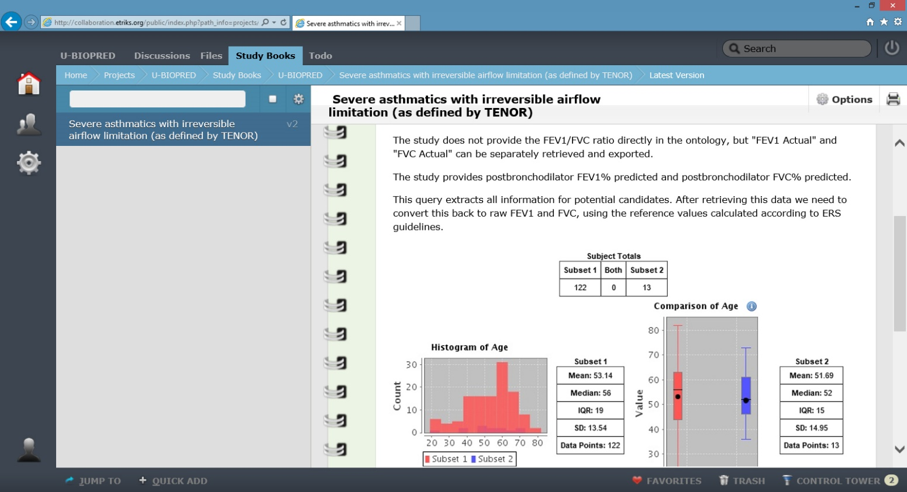
Cohort summary
A summary view of the cohort is generated with visuals
The results include the comparison about patient clinical information

Slide 34

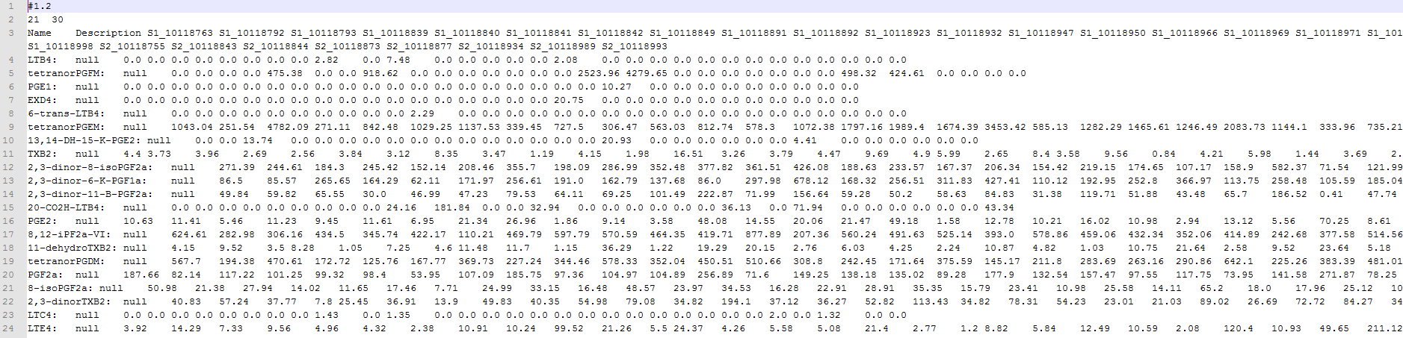
Study data export
Export data as CVS.
e.g. Lipidomic each line for one feature, etc …

Slide 35

Collaborative Knowledge Production & Sharing
Save a study with provenance
Name
Type
Researcher
Study Description
Result Description
Cohort Selection
Conditions

Slide 36
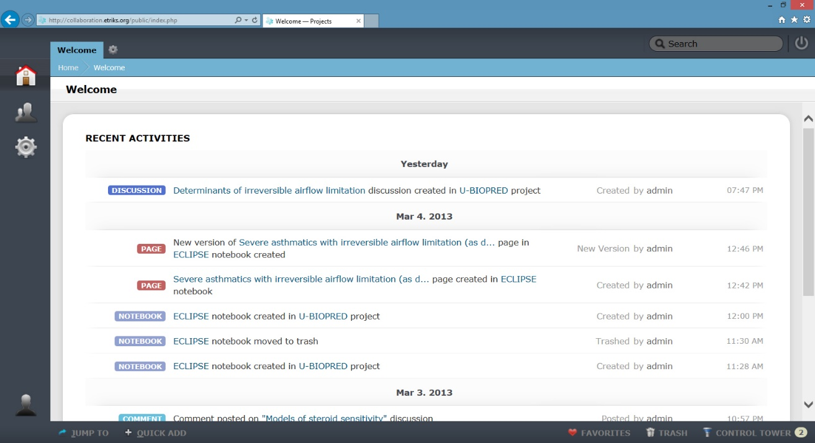
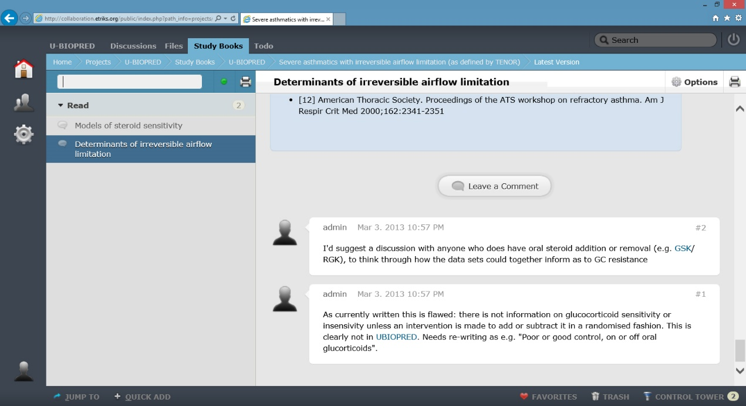
Collaborative Knowledge Production & Sharing
Collaborative investigation allows people to comment and improve
Feeds to keep the researchers up-to-date with the latest participations

Slide 37
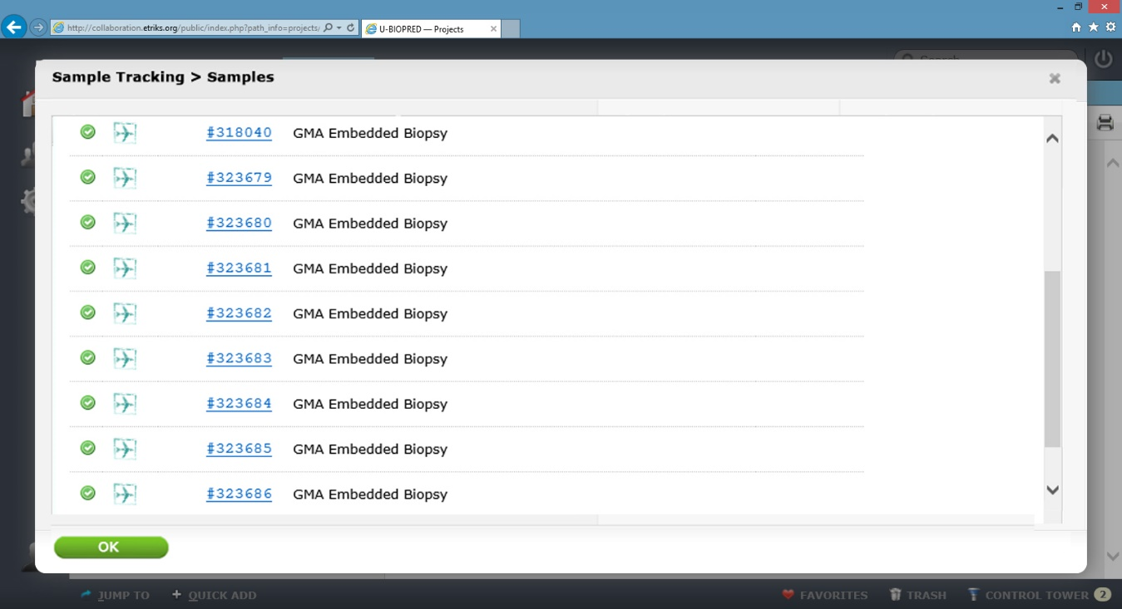
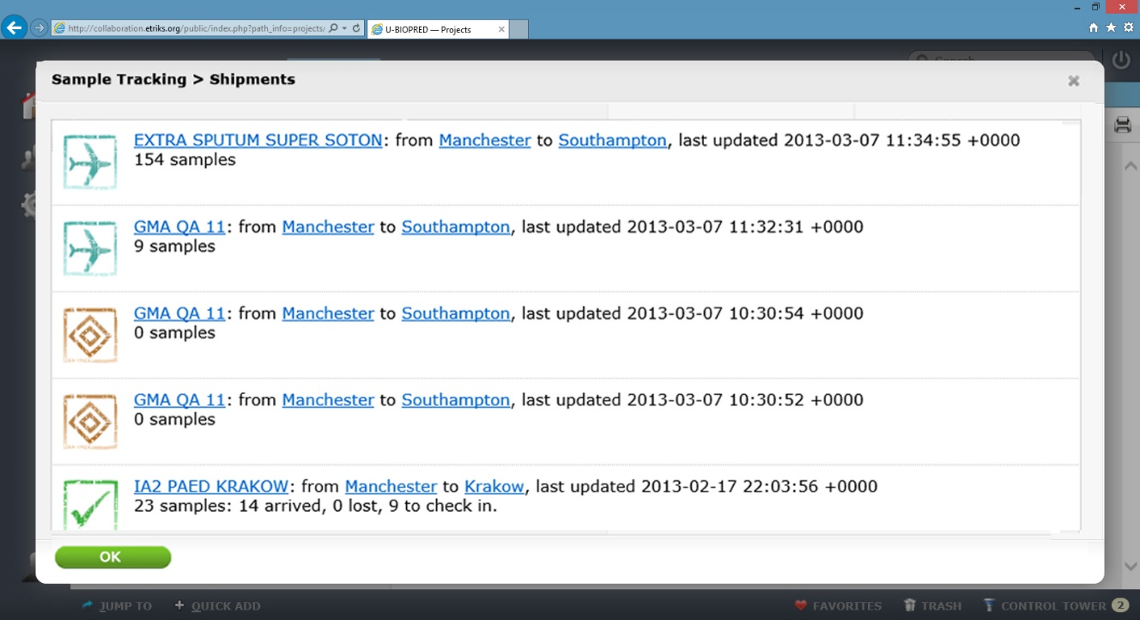
Sample Tracking
Samples and sample shipments can also be managed and tracked via the Study space

Slide 38
Service……

Slide 39
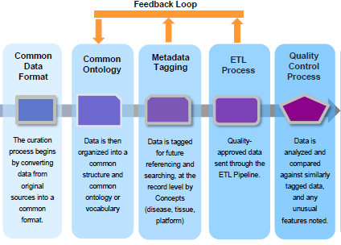
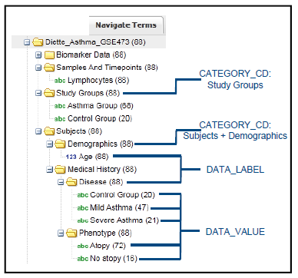
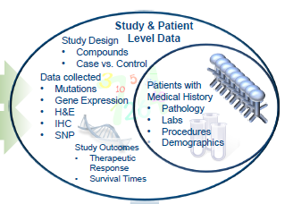
eTRIKS Curation Process

Slide 40
Information Landscape Associated to the Curation Process

Slide 41
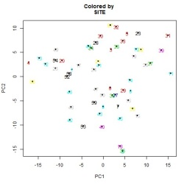
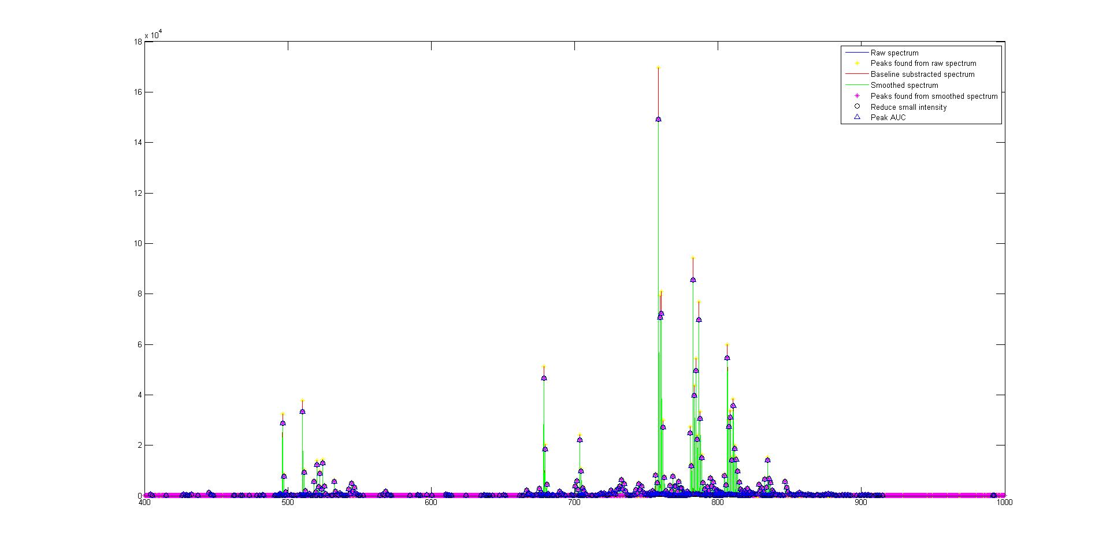
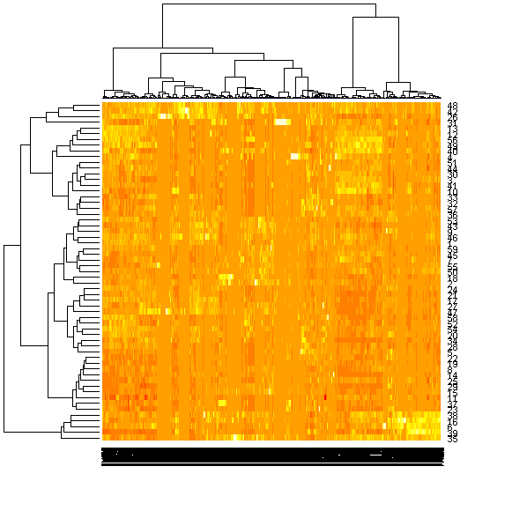
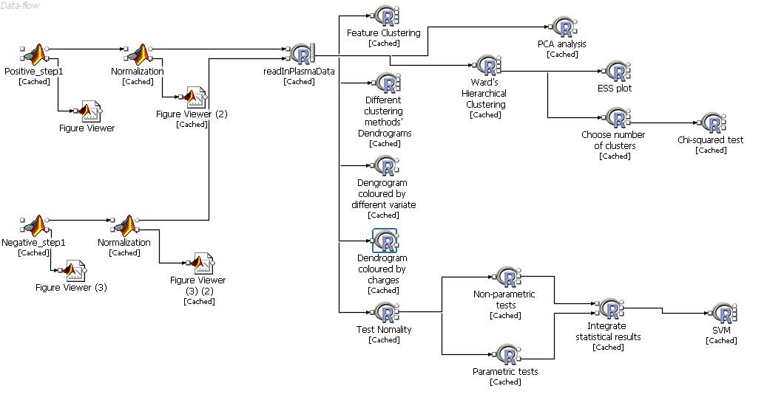
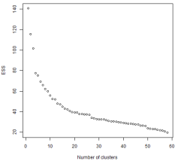
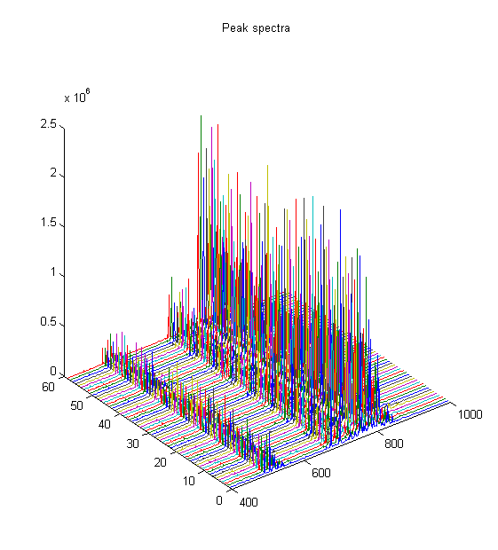
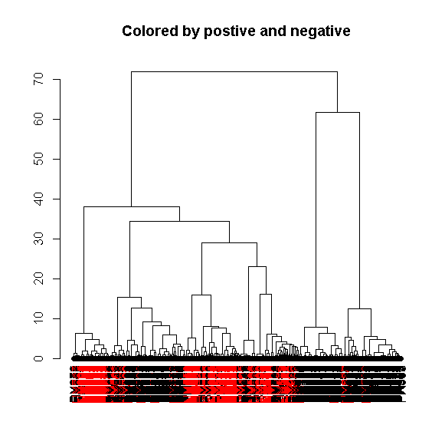
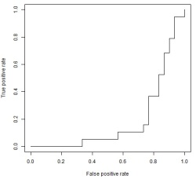
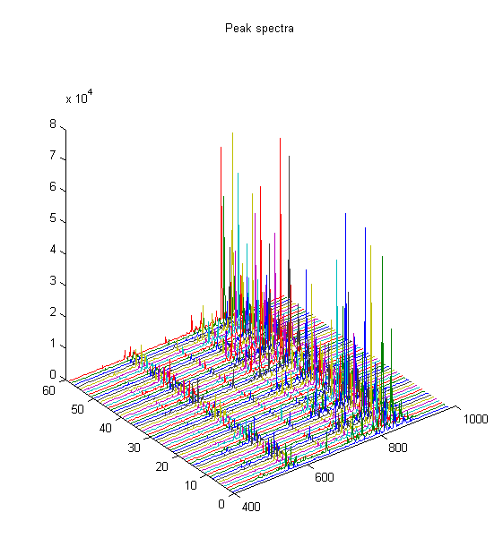
eTRIKS Analytics Research: Reusable Omics Workbenches
5-HETE, tetranor-PGD-M, PGD2, LTE4, LTB4

Slide 42

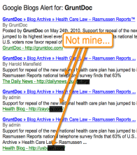

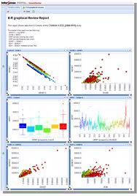
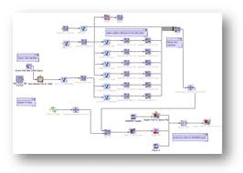
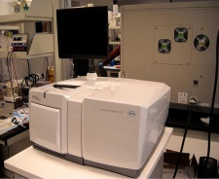
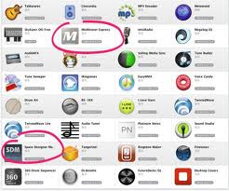
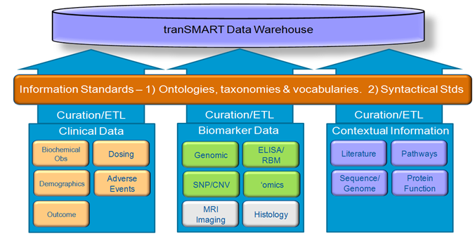
ETRIKS Supports Vendors to Provide
Software as Services
Commercial Software/Services
Open Source/Public Support Services
ETRIKS Web Services

Slide 43
eTRIKS Provision Models
Central hosting model : eTRIKS as a service
  a hosted system in Lynn supercomputing centre
  a “Genebank” like content environment for TR
  Salesforce.com –like system for collaborative project data management
Local deployment : eTRIKS as a product
  Enterprise TR platform
  Local hosting for specific project

Slide 44
eTRIKS for College

Slide 45
eTRIKS Can Provide Core Informatics Support to IC TR
Translational Project s
Curation and Analytics Services
eTRIKS Platform
IC Data Centre

Slide 46

Example: OPTIMISE Project
(Prof.Paul Matthews)

Slide 47

eTRIKS Services as the Glue and the Delivery Platform

Slide 48
Summary
eTRIKS is the EU informatics platform for collaborative translational research (23m Euro, 5 years)
eTRIKS provides the software platform as well as data/analytics service
eTRIKS team is seeking the collaboration with translational research groups in building and using the platform
eTRIKS serves to all IMI projects
eTRIKS can be the base of a translational informatics hub for international TR

