Slide 1


Study Case BCI navigation
Business Management
EPITECH • 5ème année
Sébastien Beaumer / Florian Guitton / Laurent Perraud / Benjamin Poisson / Geoffroy Tindel-Devandome

Slide 2

TABLE OF CONTENTS
Overview of the Company
Main activities
Financial status
Situation of BCI Navigation
Products

Slide 3
Overview
Few words about BCI navigation

Slide 4
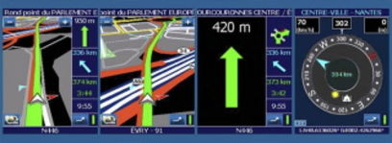
Overview
BCI navigation

Slide 5
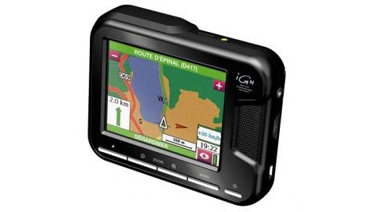

Overview
Strategic activities
Navigation « door-to-door »
International Development

Slide 6
Overview
Business situation
Financial status

Slide 7
Business Situation
What is the business situation of BCI navigation ?

Slide 8
Business situation

Slide 9
Business Proposal
How to save the business of BCI navigation ?

Slide 10
Business proposal

Slide 11
Study Case BCI navigation

