Slide 1


Enabling large scale data exploration and analysis for direct feedback to healthcare centers
  Florian Guitton
  Data Science Institute

Slide 2

Data Science Institute
Data Science Institute aims to enhance Imperial's excellence in data-driven research across its faculties

Multi disciplinary environment
The Institute’s staff contributes to more then 67 grants projects in various field and is enhanced by a large groups of Fellows and their groups running parallel high impact research

Slide 3
UK-Biobank
UK Biobank is a national and international health resource with unparalleled research opportunities, open to all bona fide health researchers.

Large publicly available cohort
More than 500 000 participants involved at different stage of the data collection process

Rich range of data modalities
More than 6000 individual variables collected longitudinally over a 5 years period in diverse modality format including genetic and detailed imaging data

Slide 4
Imperial College NHS Trust
One of the largest NHS trusts in England and together with Imperial College London forms one of the most powerful national academic health science centre.

Large secondary and tertiary care cohort
More than 1 200 000 patients attending the wards of the 6 Imperial College NHS Trust hospitals

Rich range of data modalities
Entire patient medical history jointed with biased, disease specific data modalities.

Slide 5
Borderline
Many challenges ahead

Data Standards

Large High-dimensional Datasets
Adopting and supporting data standards across the platform, i.e., CDISC compliant
Managing and manipulating large high-dimensional datasets such as genotype or imaging data

Complex Variable Selection

Scalable Distributed Computation
Supporting advanced subset selection criteria based on run-time derived variables
Efficiently distributing and executing intensive analysis workflows

Cross-Study Comparison
Supporting analysis and comparison of data from different studies and potentially different and heterogeneous data sources

Slide 6
Architecture Considerations
Opportunity to start reconsidering the application stack from the ground up re-evaluating technologies and tools.

Modern web application
Based on the most modern and popular web framework, we are making Borderline extendible on many levels. The whole interface is pluggable and integrates with rich in-the-browser code editing

Microservice Architecture
The backend of Borderline and the components it relies on are constructed around the principle of microservices, dividing software in small executables

System Security
Data safety as a first citizen. Building on the work done with eTRIKS Horde and its bidirectional hybrid encryption system.

Slide 7



Borderline
Microservice Architecture for Scalability
eTRIKS Analytics Engine
Borderline
eTRIKS Data Store
















MongoDB
Swift







Redundant Storage Area Network

Slide 8
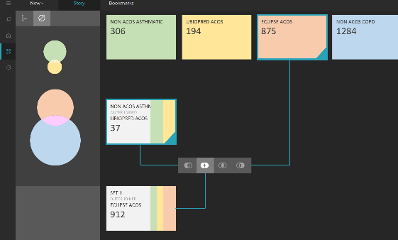
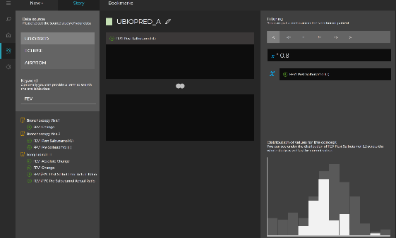
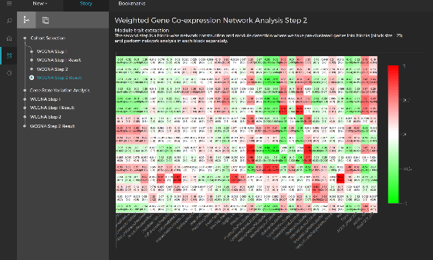
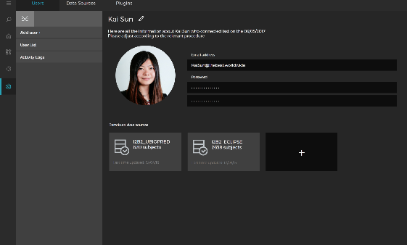
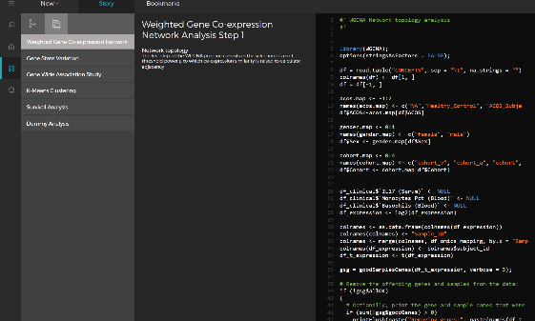
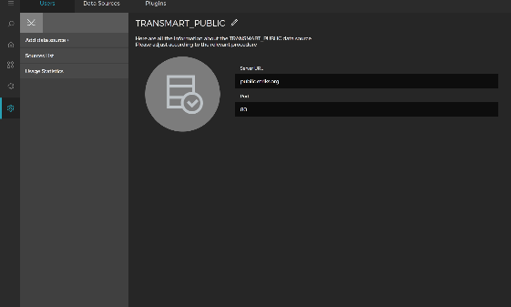
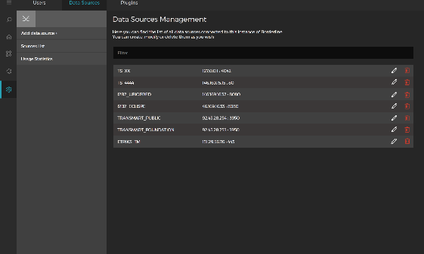
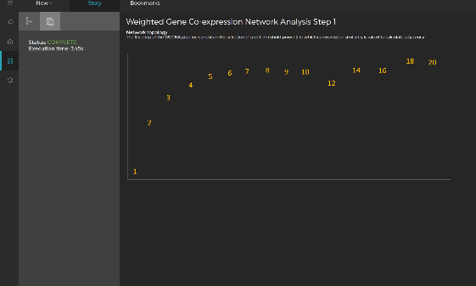
Borderline
Developing user oriented tooling
Logic operation on cohorts
Familiar variable constraining
Data exploration in “stories”
Centralise user delegation
In-browser code edition
Multiple data sources
Rich extensibility
Audit and reporting

Slide 9
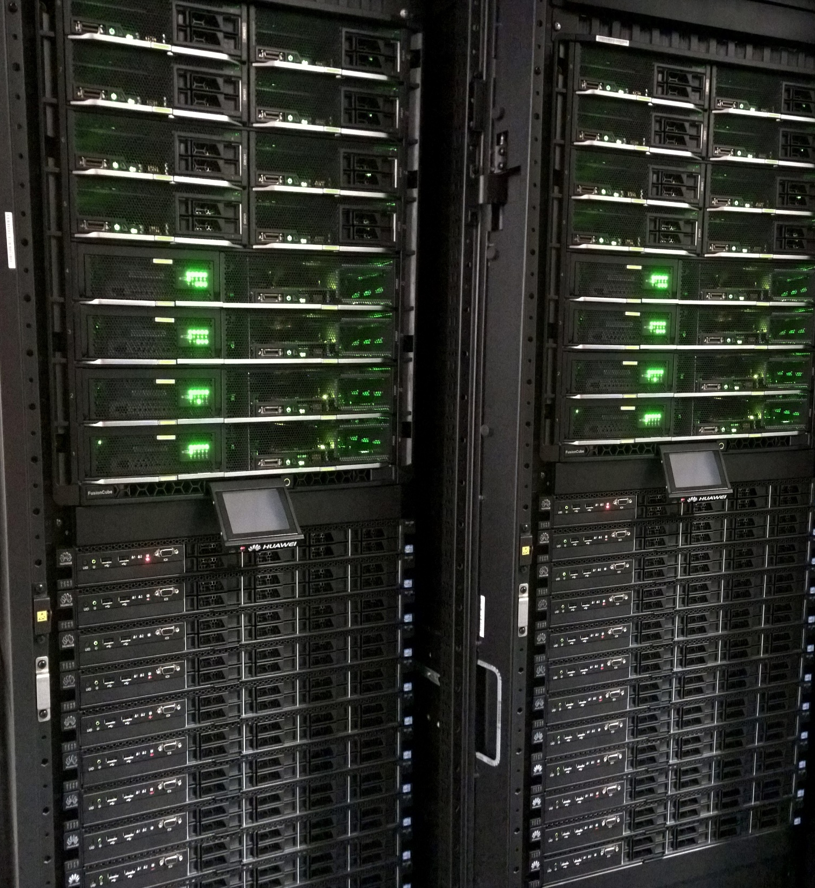
Infrastructure progress
Large investments planned over the next 5 years to allow 300 researchers to get access and analyze their data.

First “stones” already in place
More than 50 servers and 500TB of storage supported by a 80Gb/s network have already been deployed for the project following a £ 440.000 investment.

Scaling to ever-growing numbers
The project it currently dealing with 140TB of preliminary data and targets the handling of up to 1PB by March 2020

Slide 10



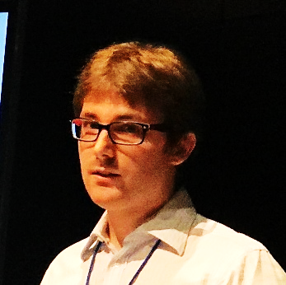


Borderline
The team
Florian Guitton
Jean Grizet
Pierre-Marie Danieau
Axel Oehmichen
Ibrahim Emam
Frontend development
Backend development
Backend development
eTRIKS Analytical Engine
eTRIKS Data Store
General architecture and web from React to the coding of the RxJS backed event bus and built in IDE
Scalability design and layer data oriented middleware abstraction propelled by NodeJS and top knowledge
Scalability design and layer data oriented middleware abstraction propelled by NodeJS and top knowledge
The art of large scale data distribution and computation
from the Spark supported eTRIKS Analytical Engine
Brining on board the expertise of data standard management and manipulation

Slide 11
Borderline
Resources

